Slide 2


Grommet
HPE’s Open Source UX Framework
Tracy Barmore Design Lead
Alan Souza Development Lead

Slide 3

What is grommet
We've built a set of tools on top of React.js and Sketch that allow developers and designers to create beautiful, comprehensive, flexible, and accessible experiences for all device types in one easy to use package.

Slide 4
Speed up development
We provide all the development guidance and components along with the design resources you need to take ideas from concept to a real application.
Notes:
There is no tricks or magic here. We’ve created a set of UI components based of React that already have baked in design. We do this at the element level—text, color, images all the way up to a full page or site template.

Slide 5
Proving it Live
Notes:
The Design to Develop Handoff exercise live with Tracy Barmore and Alan Souza.

Slide 6
Proving it Live
All resources from live demo of Image Library application can be found on Grommet’s Github:
https://github.com/grommet/image-library

Slide 7
Notes:
The Design to Develop Handoff

Slide 8
our story

Slide 9
Backstory
Grommet is the in-house UX team for HPE.
We we’re formed to make frontend design and development easier for an engineering focused organization.
The design and development tools had to be widely accessible and easy to use.
The design language was created to help inform and strengthen the brand while being flexible enough to work in different business contexts.
The UX plays a key role in every aspect of our products and culture you see today.
Notes:
Design Language (sales, marketing, business apps, native, mobile, ops, etc)

Slide 10


grommet drivers
100ms
70%
50%
75%
To make a
first impression
Projects fail by not
attracting users
Decrease in
development costs
Increase in sales
https://www.ncbi.nlm.nih.gov/pubmed/16866745
http://www.nea.com/blog/the-future-of-design-in-start-ups-survey-2016-results
https://www.experiencedynamics.com/blog/2014/07/making-strong-business-case-roi-ux-infographic
https://s3.amazonaws.com/coach-courses-us/public/theuxschool/uploads/The_Trillion_Dollar_UX_Problem.pdf?submissionGuid=71964d76-ac6c-4a5e-b6fe-eb6a24b57a17
Notes:
100ms - https://www.ncbi.nlm.nih.gov/pubmed/16866745
----------
In 2016, a design study of 408 companies found that the higher the investment in UX, the greater the increase in sales
Higher customer retention and customer engagement
Faster product cycles.
Those companies which invested the most, and who considered themselves to be fully user-centric, saw their sales increase by a 75%.
HPE 12 billion dollar company. Staggering increase.
http://www.nea.com/blog/the-future-of-design-in-start-ups-survey-2016-results
----------
One of the main areas of saving that UX brought about was development time. UX designers reduce the time developers needed to re-work of “fix” a product by up to 50%.
Designers can fully flesh out, prototype, rework and test before a developer has even started.
- It is a lot cheaper to fix a product before implementation, than once development has started.
It also means that developers can spend their valuable time working on products through to completion or innovating in other areas.
It was found that companies that invested in UX design were able to release their products earlier, giving them the edge against the competition.
https://www.experiencedynamics.com/blog/2014/07/making-strong-business-case-roi-ux-infographic
-----------
It is also found out that 70% of projects fail due to an inability of a company to either attract or retain users.
UX designers improve navigation, ease of use, and ‘delightful’ interactions, resulting in higher user satisfaction.
Also, sales growth increases due to products being tailor-made with the user’s needs and goals in mind.
https://s3.amazonaws.com/coach-courses-us/public/theuxschool/uploads/The_Trillion_Dollar_UX_Problem.pdf?submissionGuid=71964d76-ac6c-4a5e-b6fe-eb6a24b57a17

Slide 11
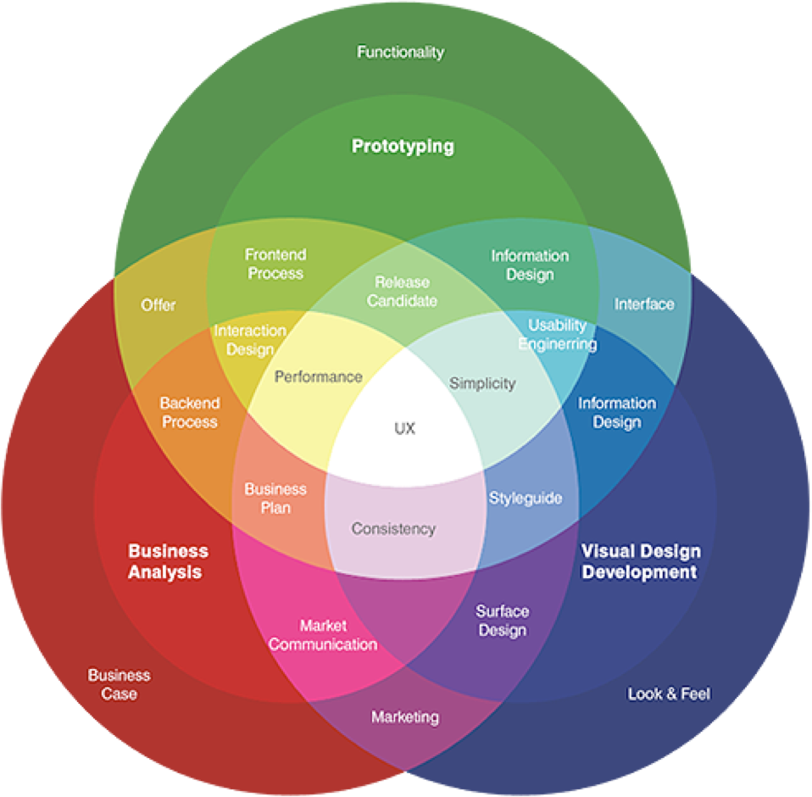
grommet simple
* https://ia.net/topics/the-spectrum-of-user-experience-1/

Slide 12
grommet elements
Notes:
What makes us great

Slide 13
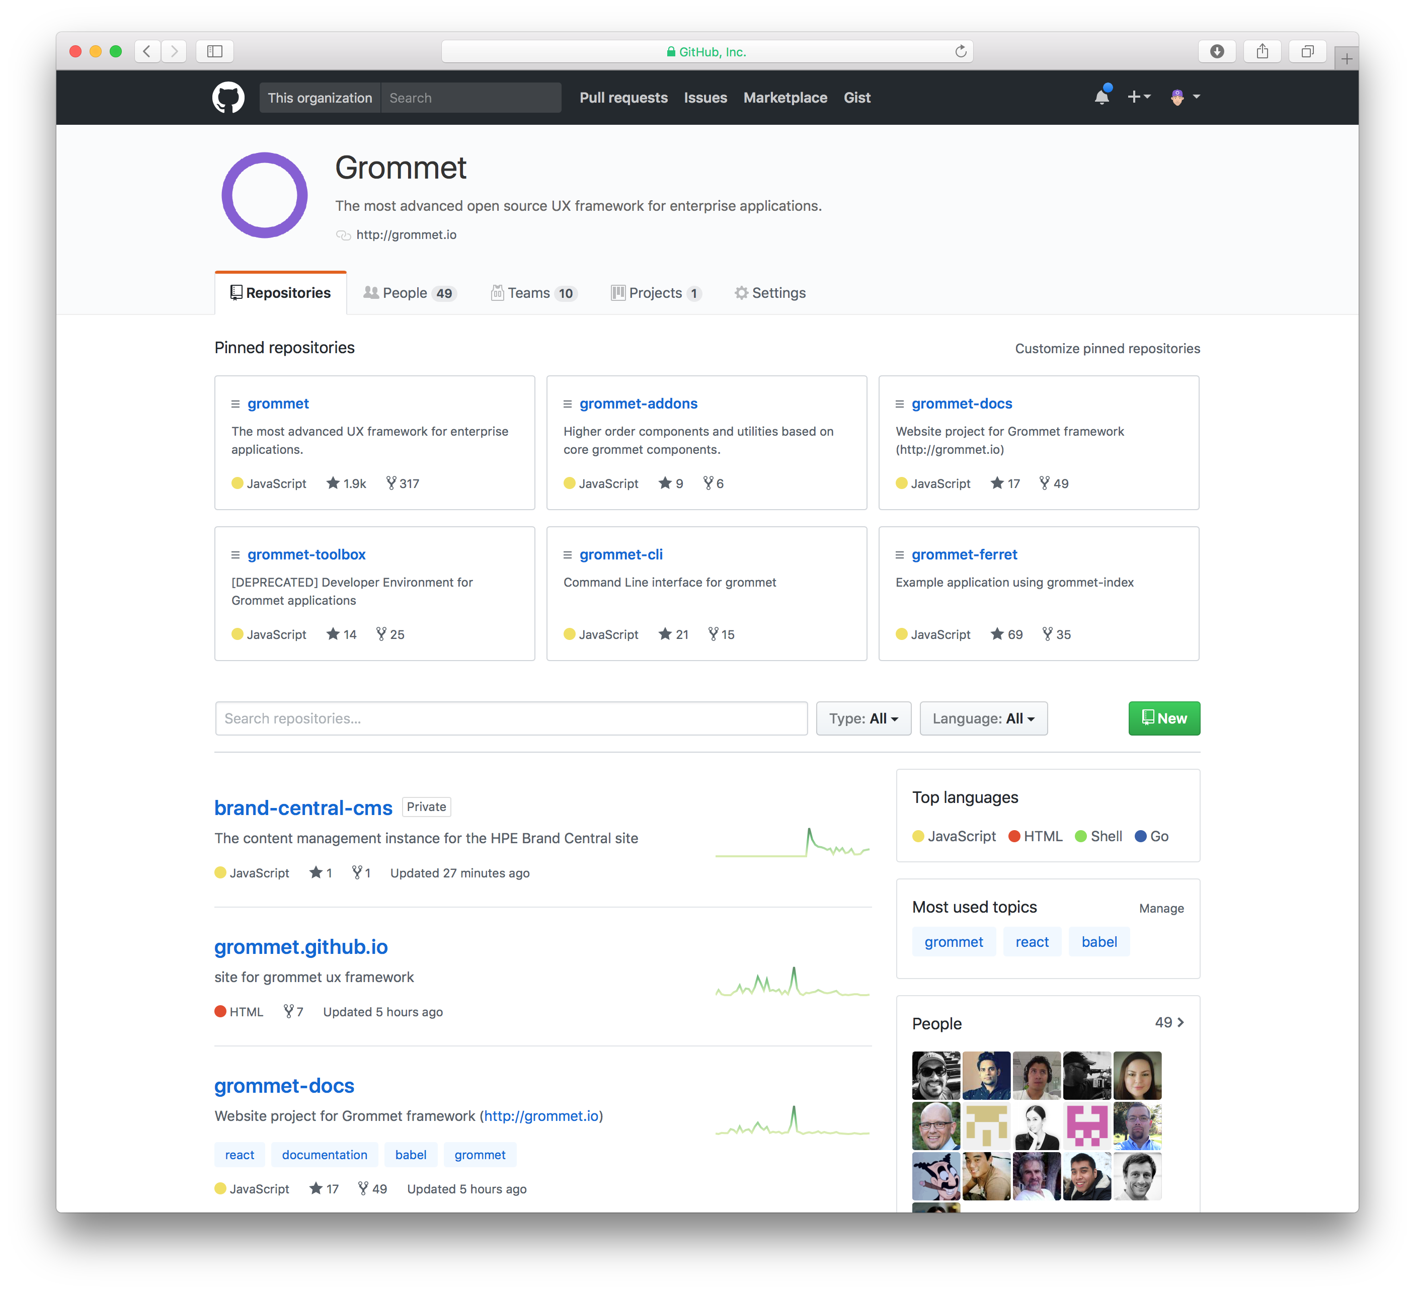
grommet is open

Slide 14
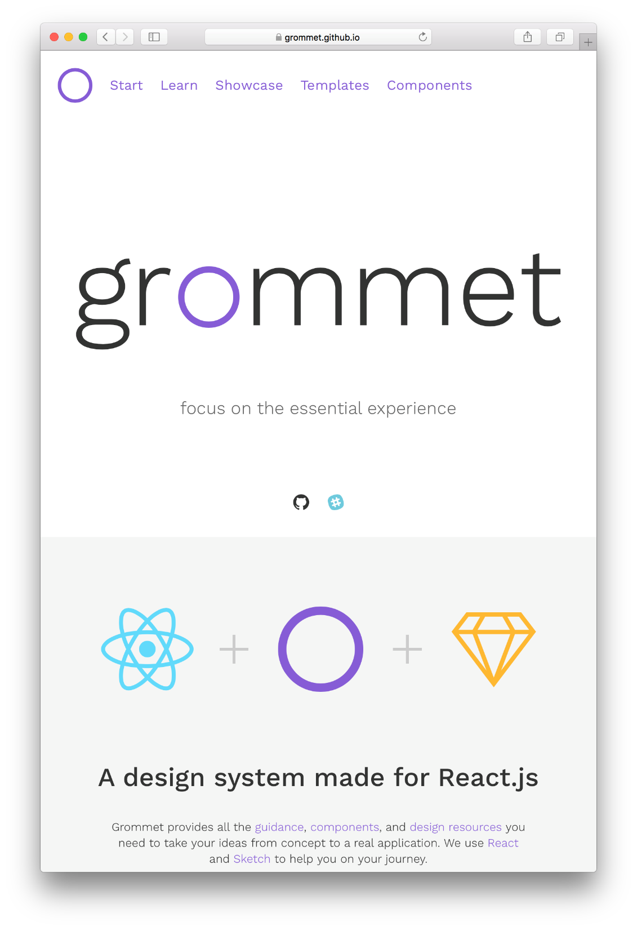
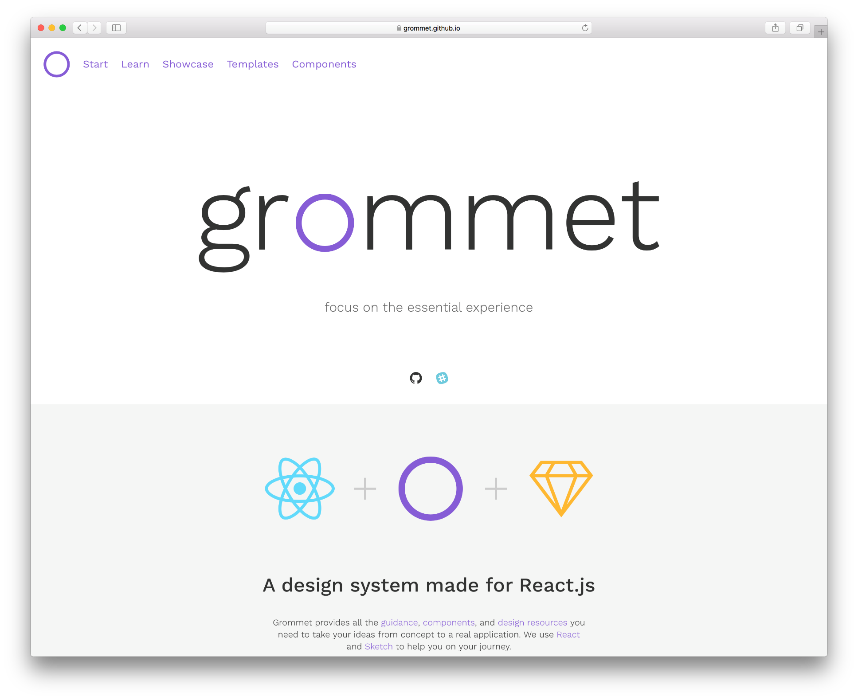
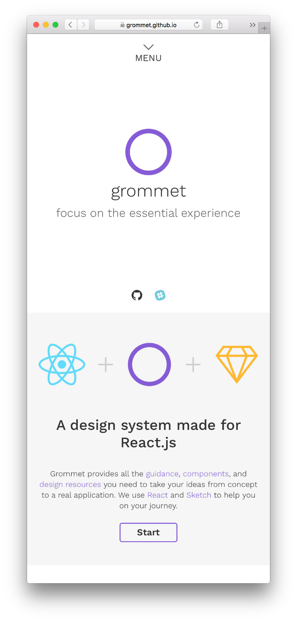
grommet is responsive

Slide 15
grommet is accessible
WCAG AA Compliance
Screen Reader Support
Localization Support
Keyboard-only Traversal
Screen Magnification
Skip Links

Slide 16


grommet is flexible
Coming soon…

Slide 17

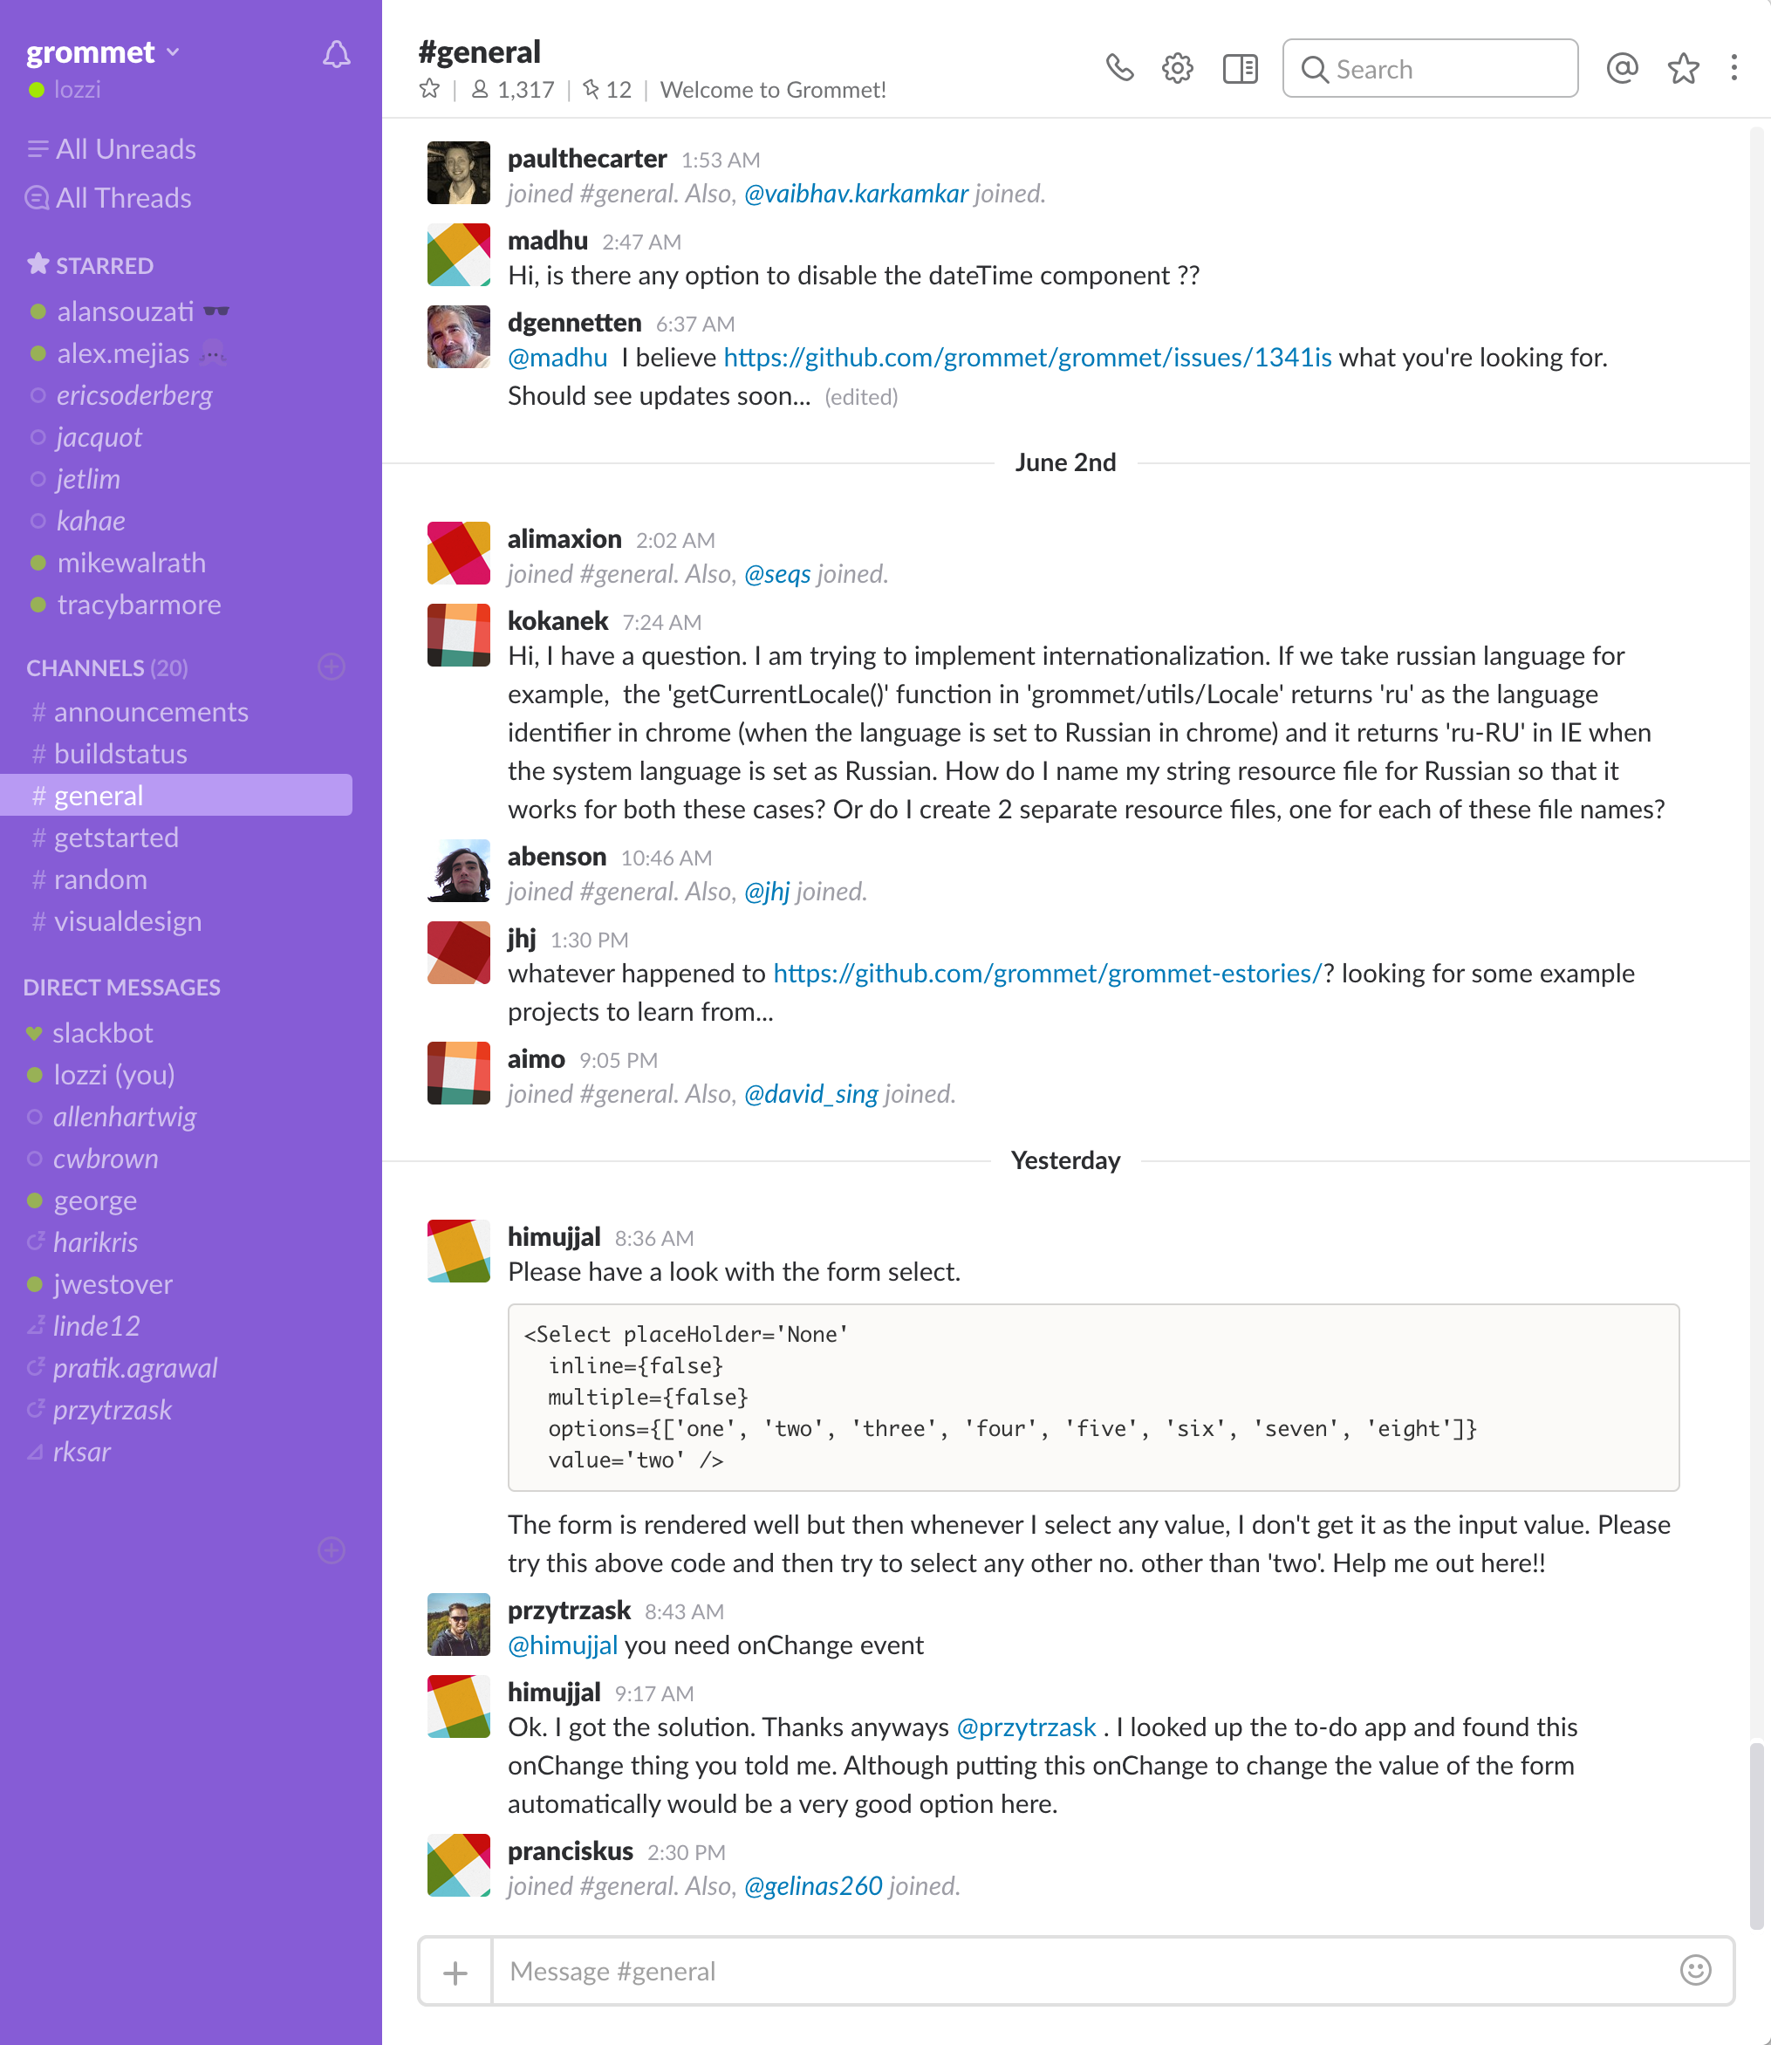
grommet is a community

Slide 18
design and develop

Slide 19
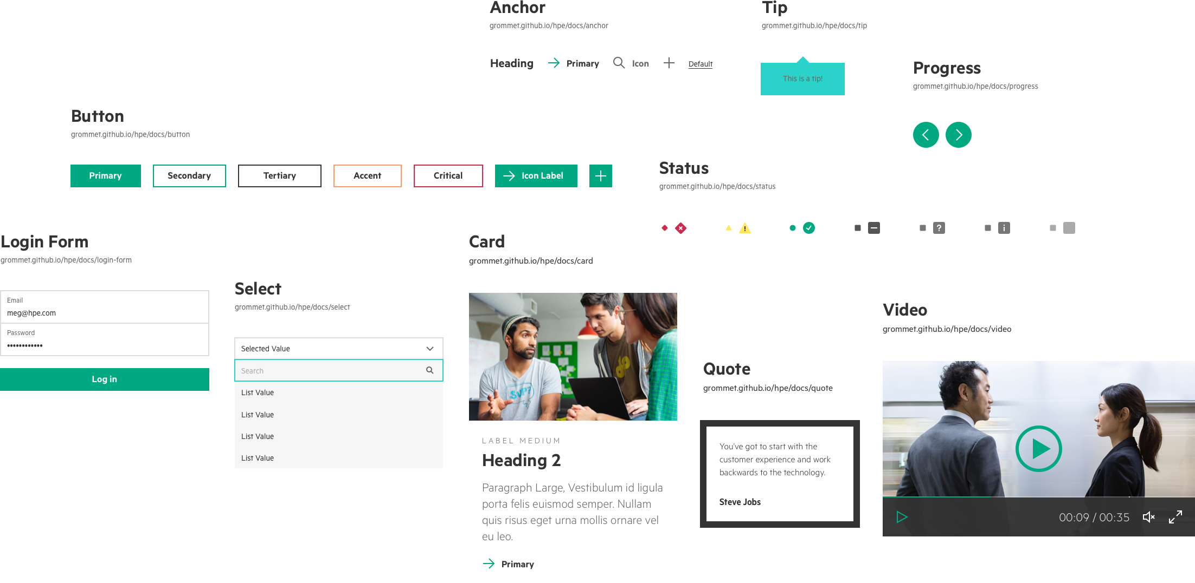
grommet design

Slide 20
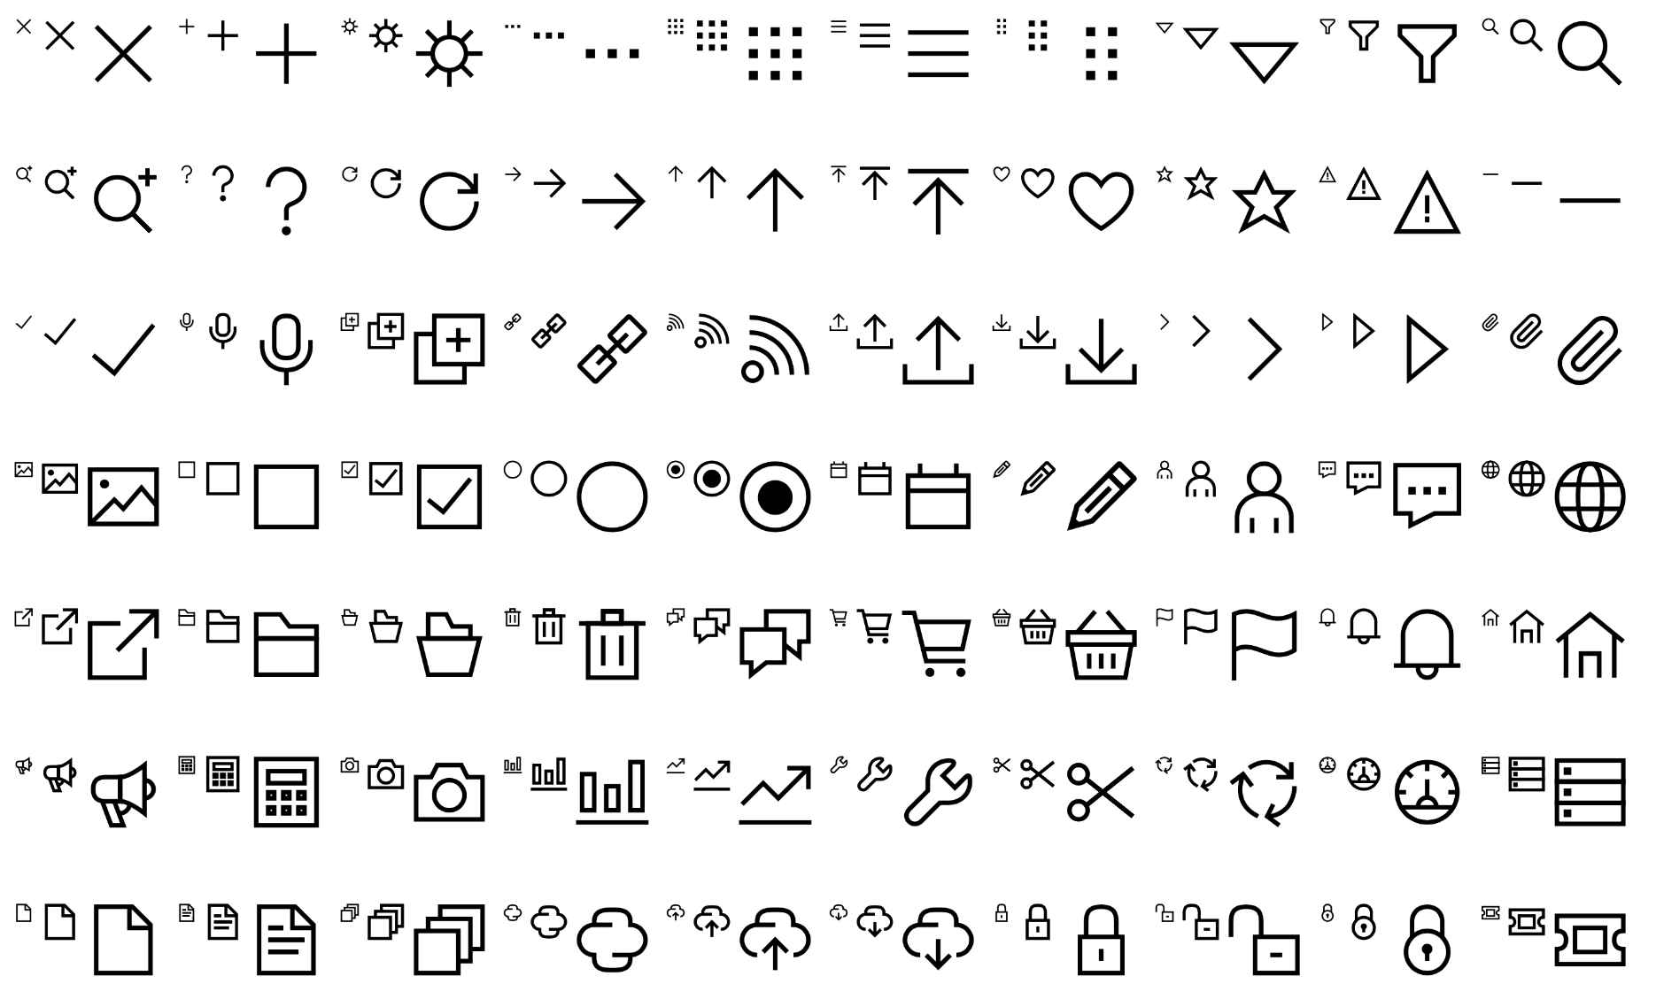
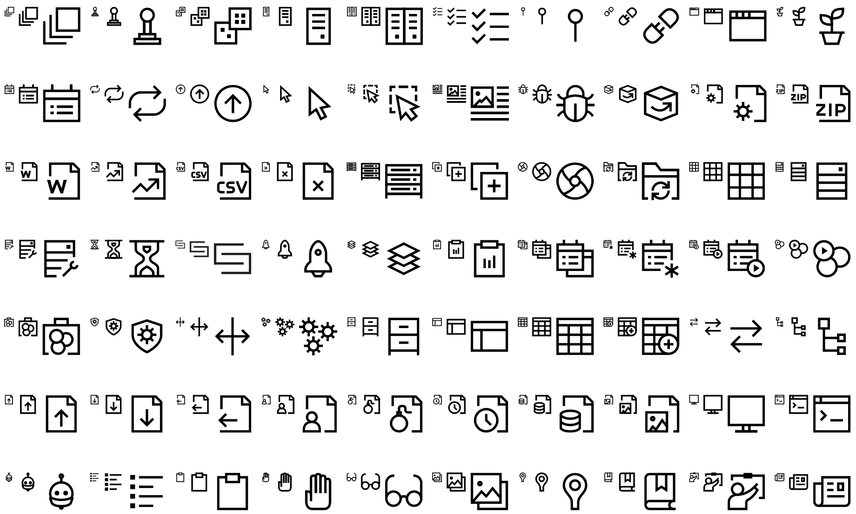
grommet iconography

Slide 21
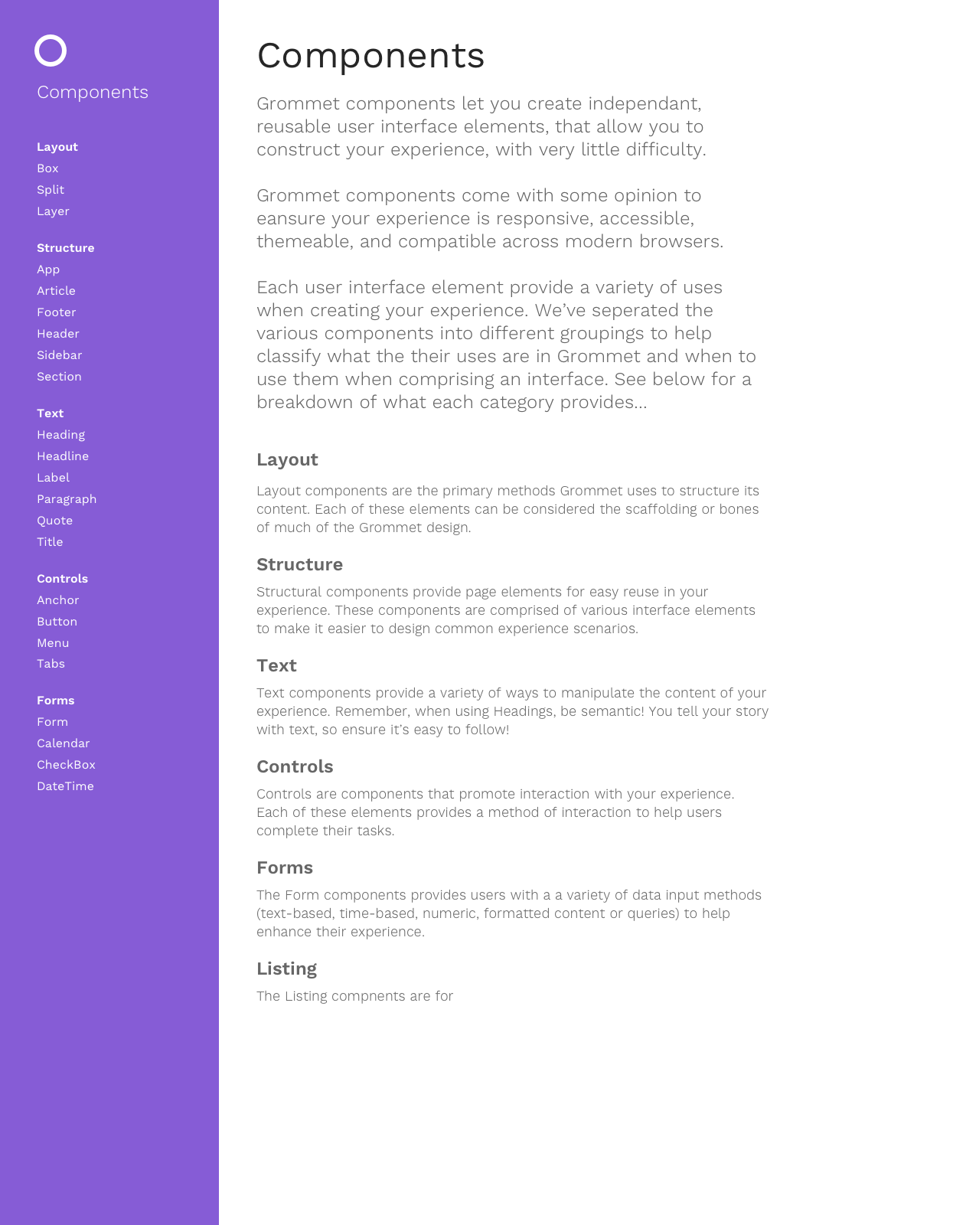
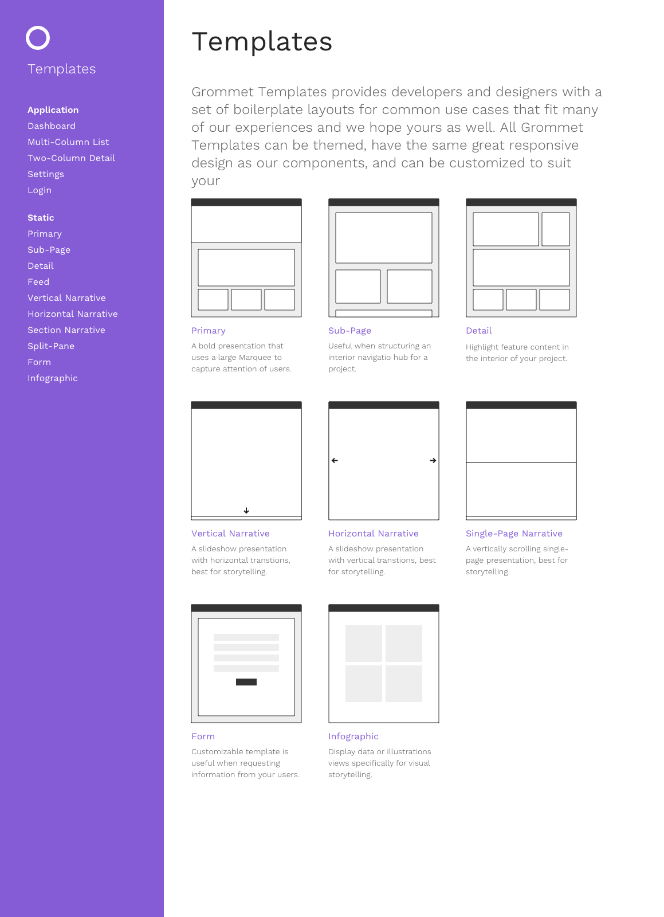
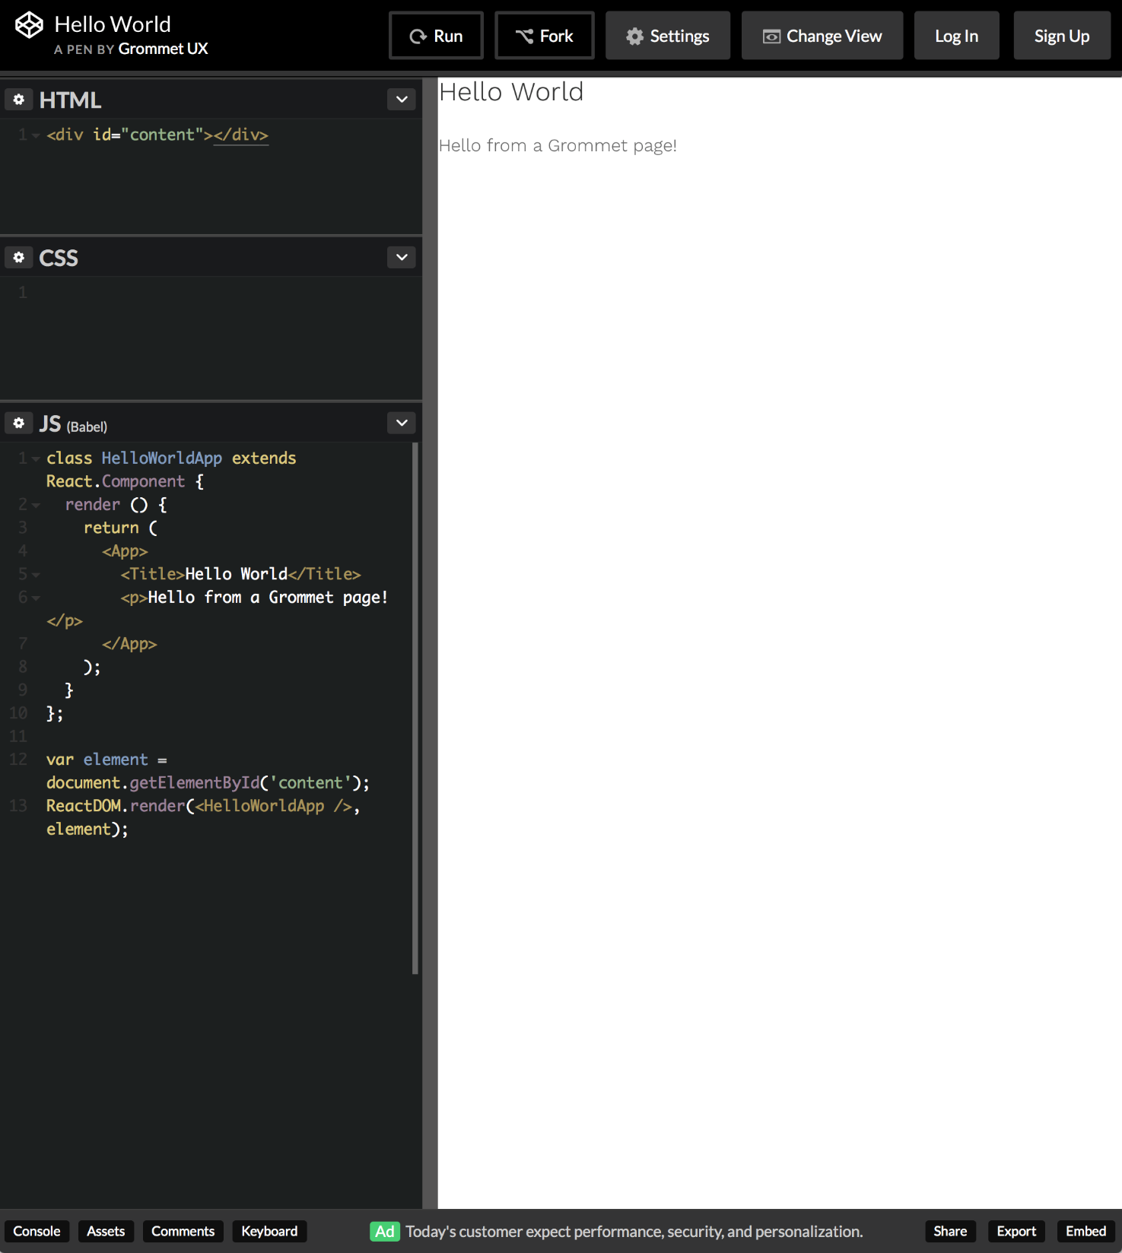
grommet develop

Slide 22
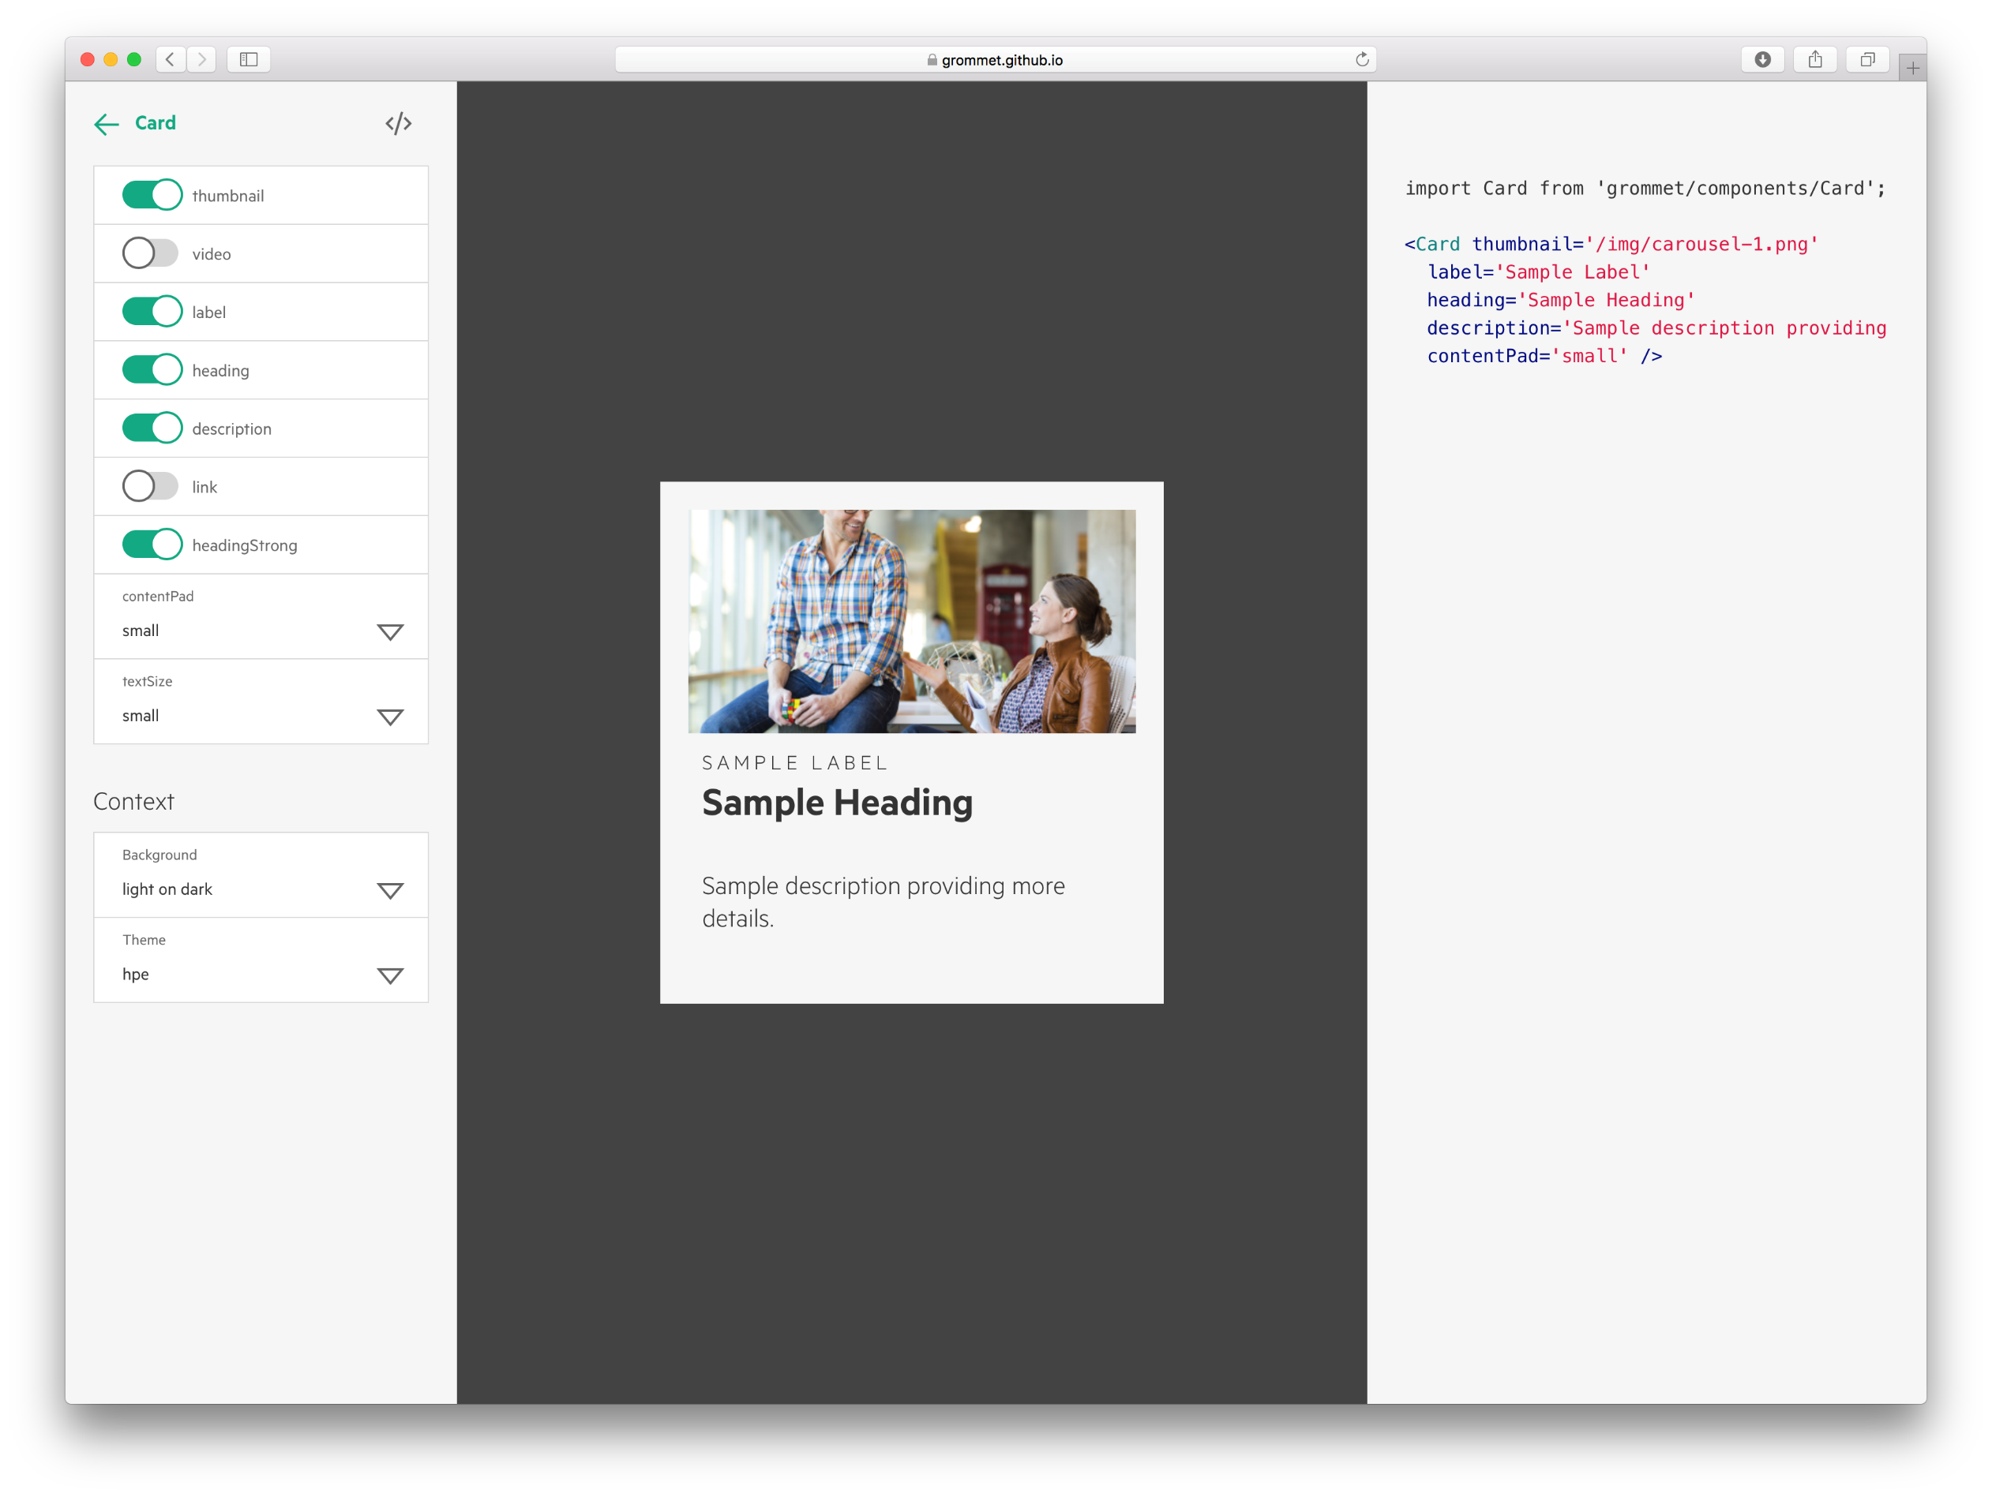
grommet live preview

Slide 23
grommet by the numbers

Slide 24
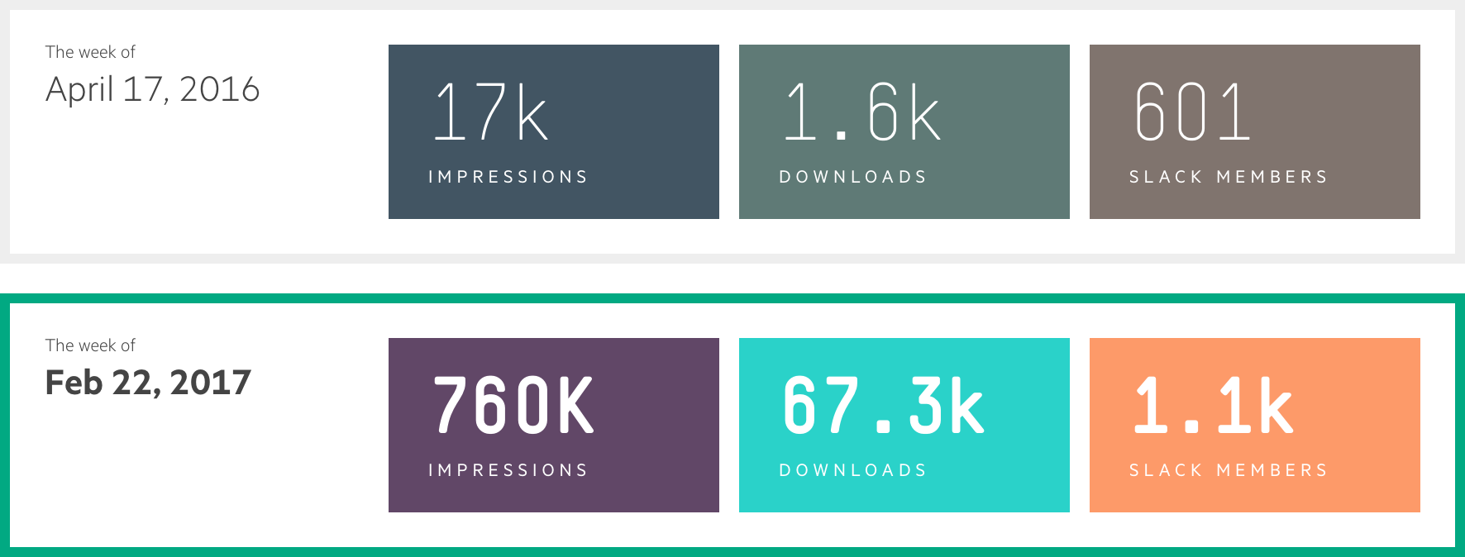
grommet year over year
1
2
3
¹ https://twitter.com/grommetux
² http://npmjs.com/package/grommet
³ http://grommet.slack

Slide 25
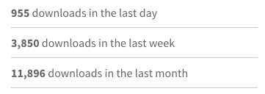
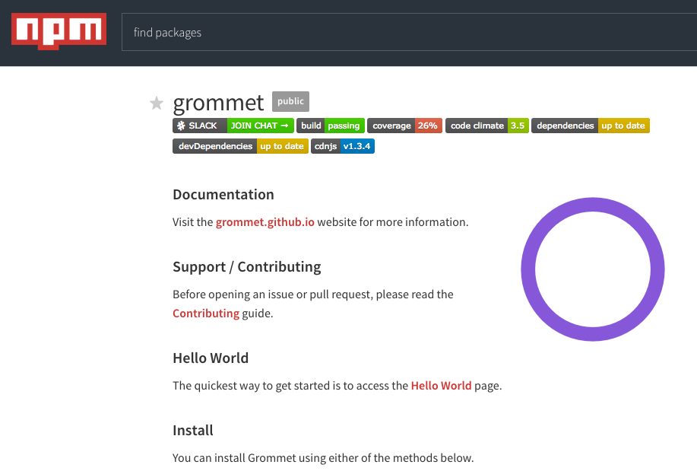
grommet downloads
*
* http://npmjs.com/package/grommet
Notes:
Code downloads as of March 23, 2017

Slide 26
grommet GitHub stats
#1
496
1,489
62
*
HPE Open Source Project
Pull Requests
Stargazers
Contributors
* http://github.com/grommet
Notes:
Started from within HPE

Slide 27
grommet project costs savings*
Due to the continuous increase in the
reuse of code and in-house built grommet
management systems.**
26%
65%
75%
83%
88%
Pathfinder
Labs
BrandCentral
MyRooms
Data Center Care
** Estimates limited to HPE Experience Marketing projects
** Costs compared to average consulting hourly rate
Notes:
The addition of the grommet CMS and the developer tools we were able to simplify execution and deliver some gorgeous sites.

Slide 28

grommet overall savings
$1.5M
in year to date savings by
Using Grommet instead of
external agencies.
** Estimates limited to HPE Experience Marketing projects
** Costs compared to average consulting hourly rate

Slide 29
grommet showcase

Slide 30
grommet aruba profiler

Slide 31
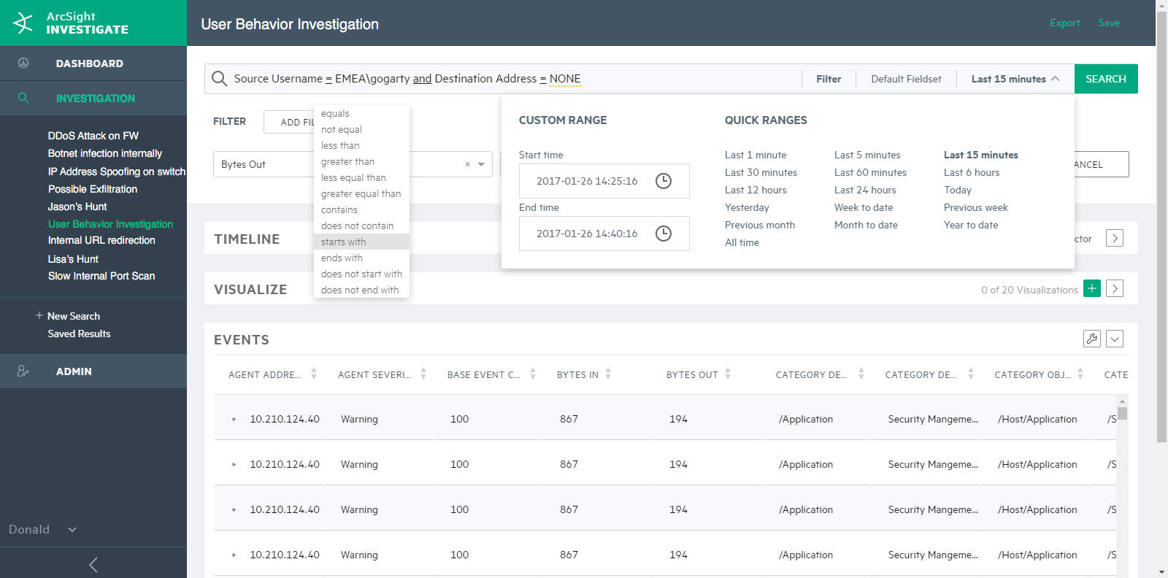
grommet ArcSight Investigate

Slide 32
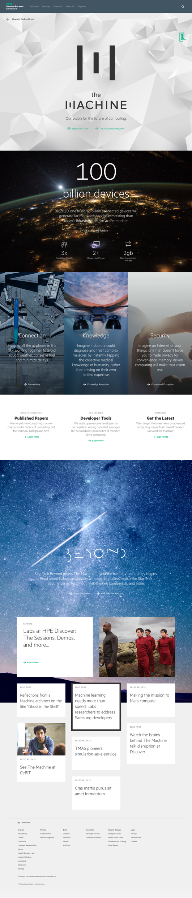
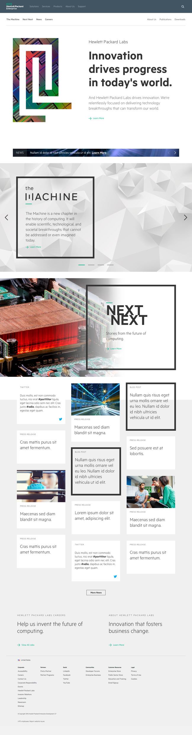
grommet hpe labs www.labs.hpe.com

Slide 33
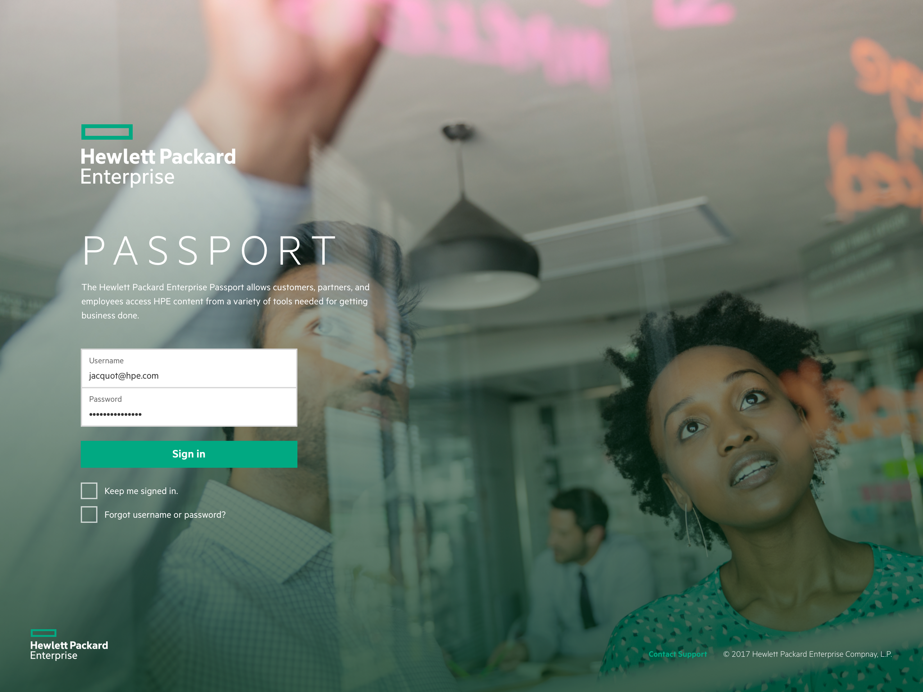

grommet HPE Passport

Slide 34
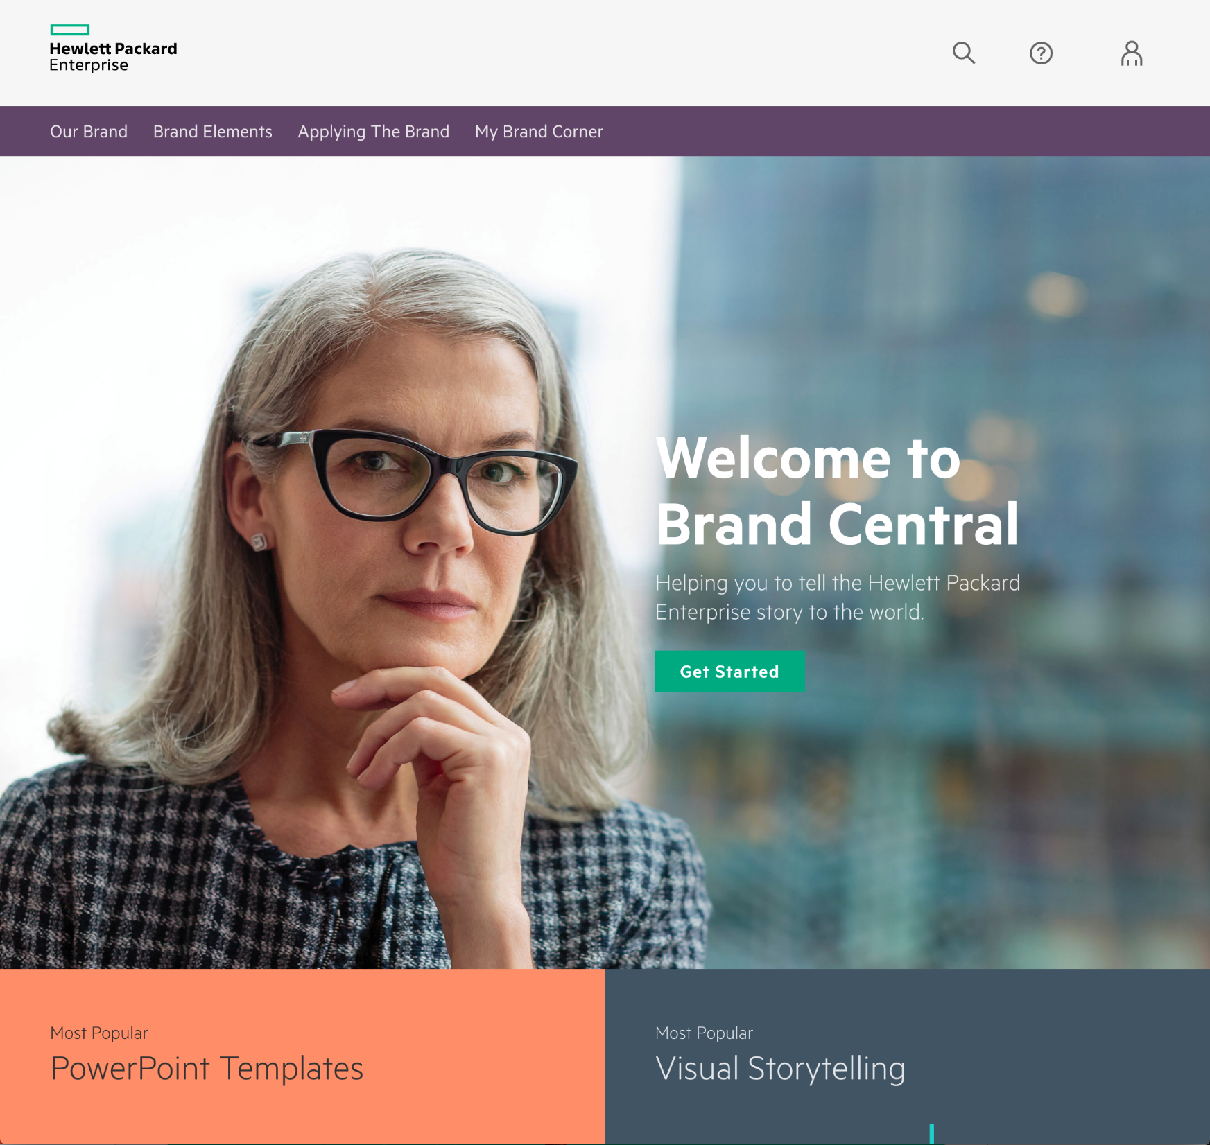
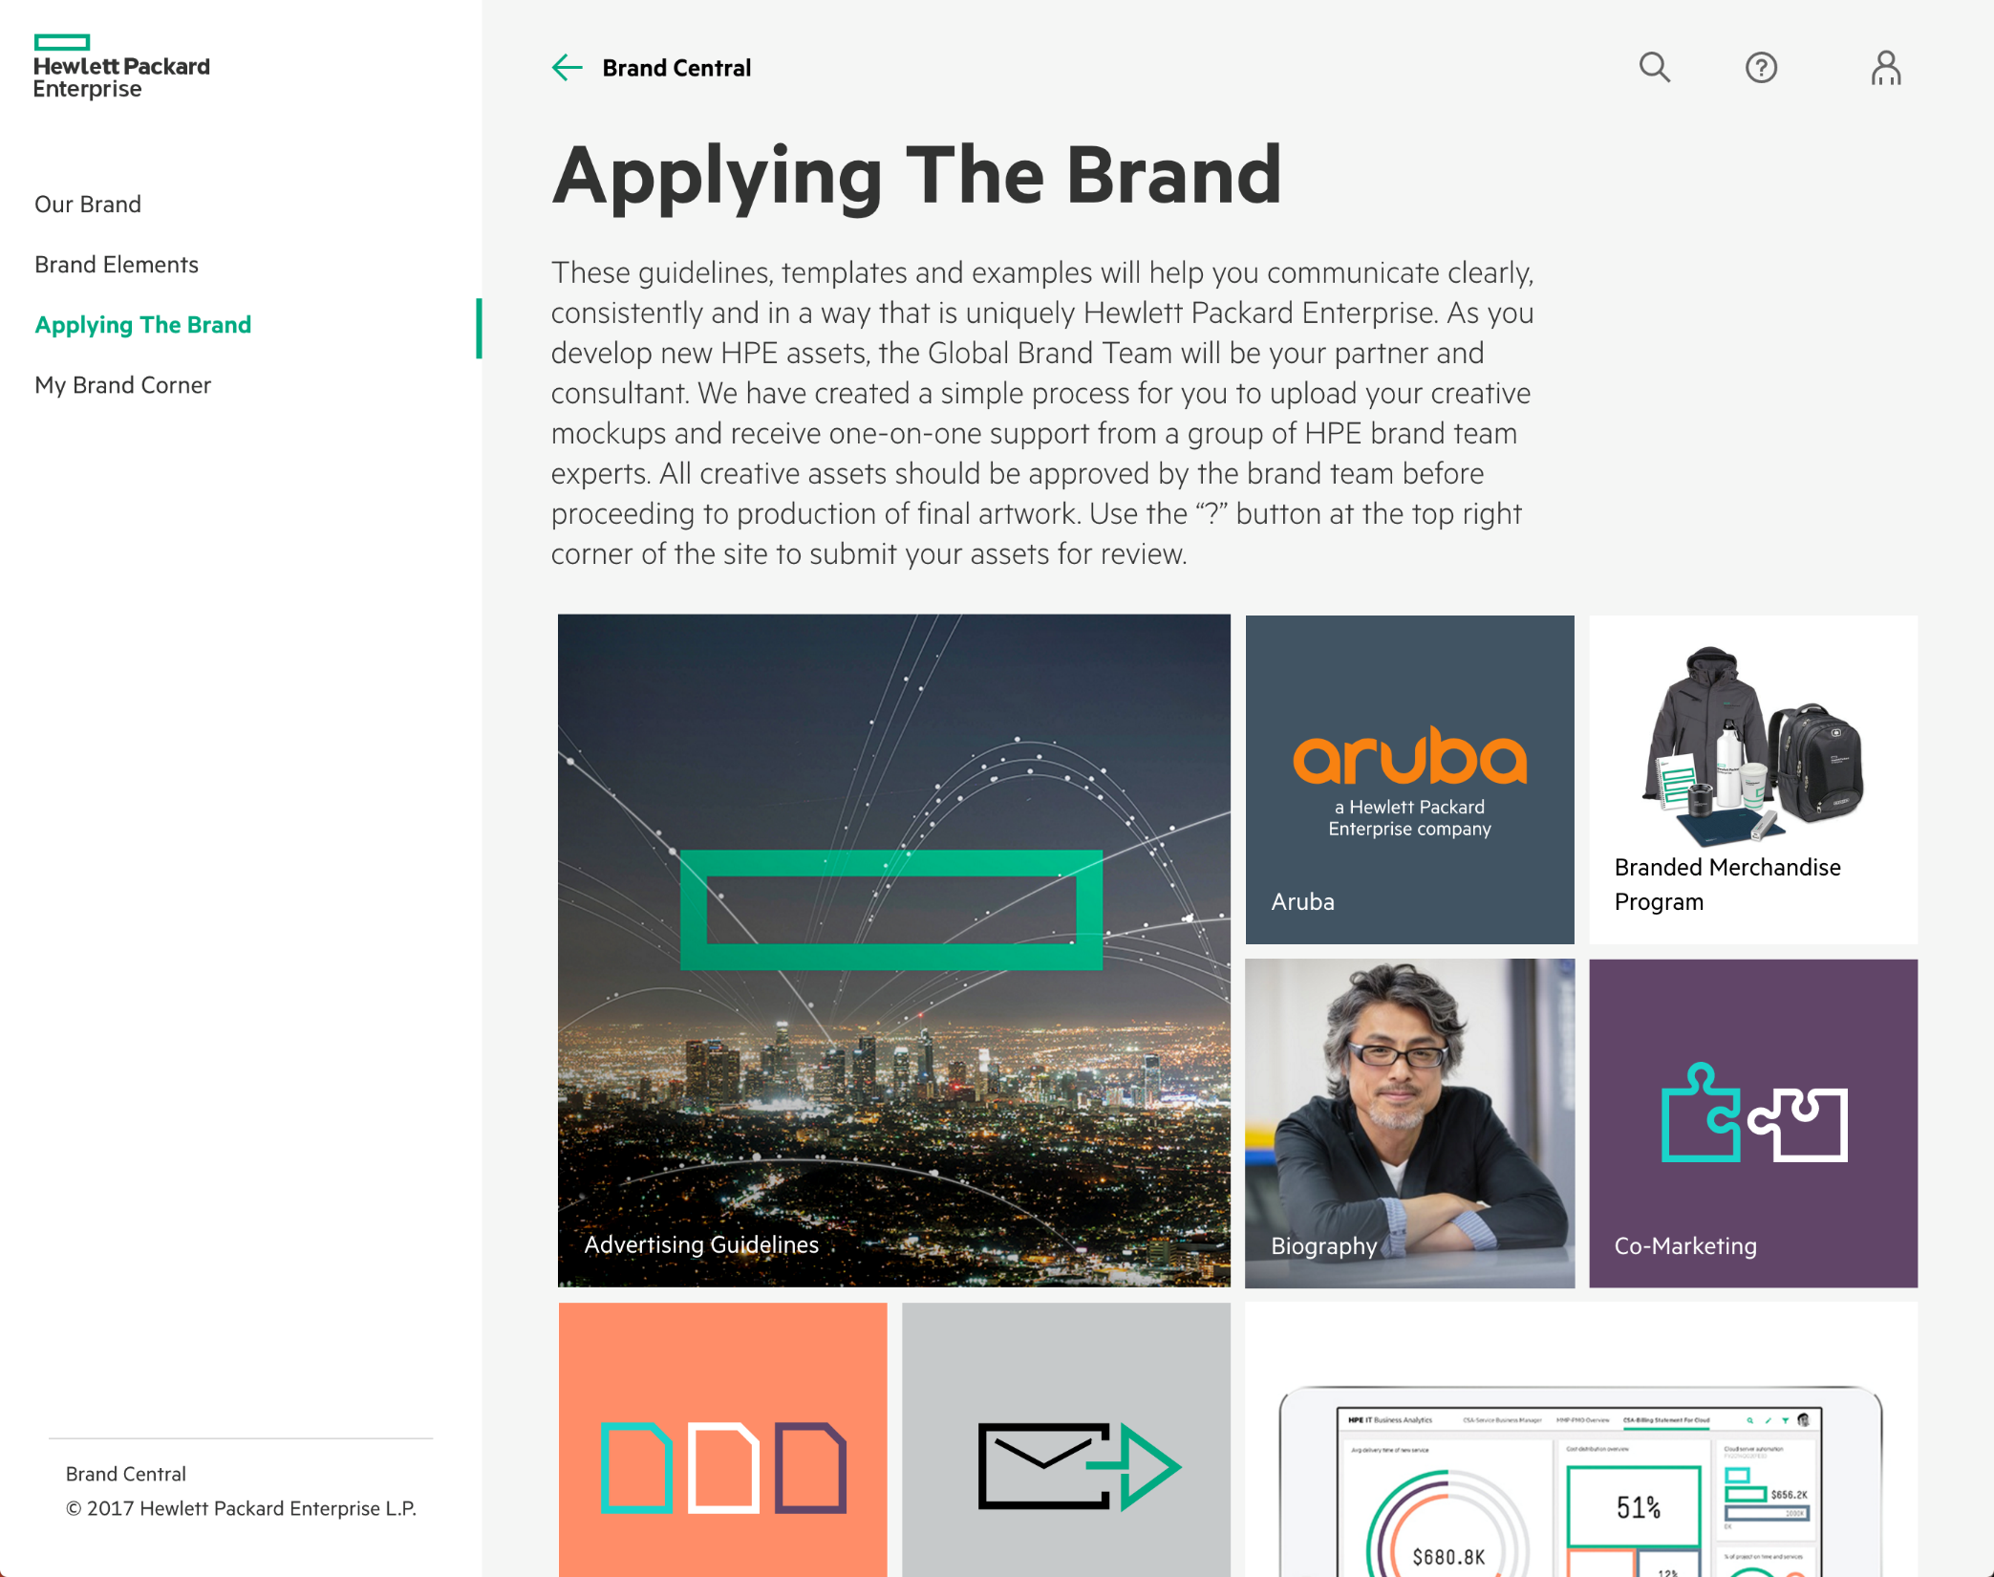
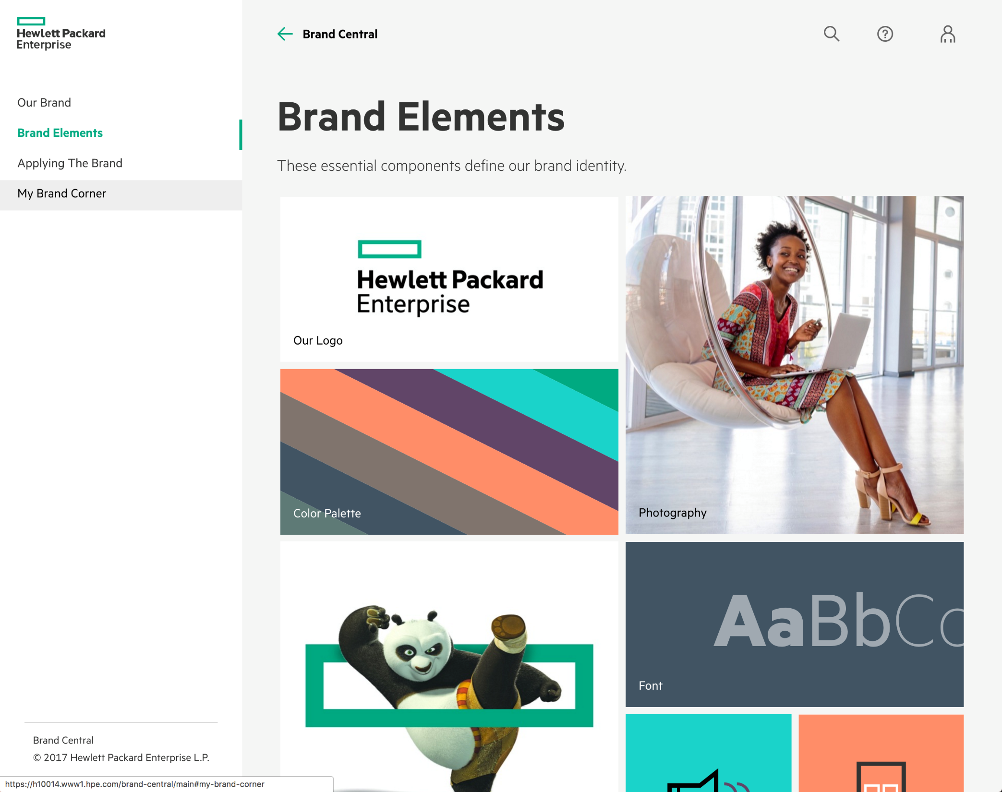
grommet HPE BrandCentral www.hpe.com/brandcentral

Slide 35
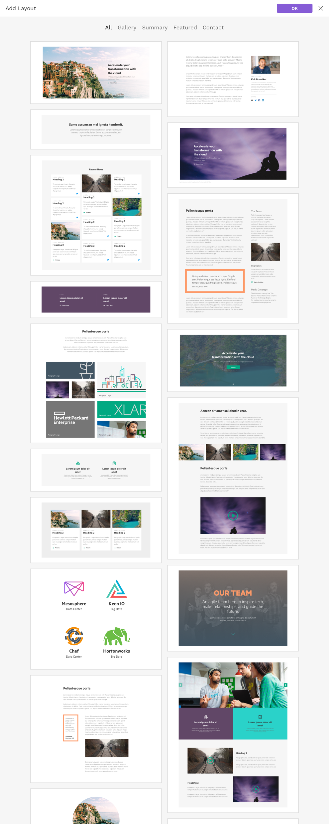
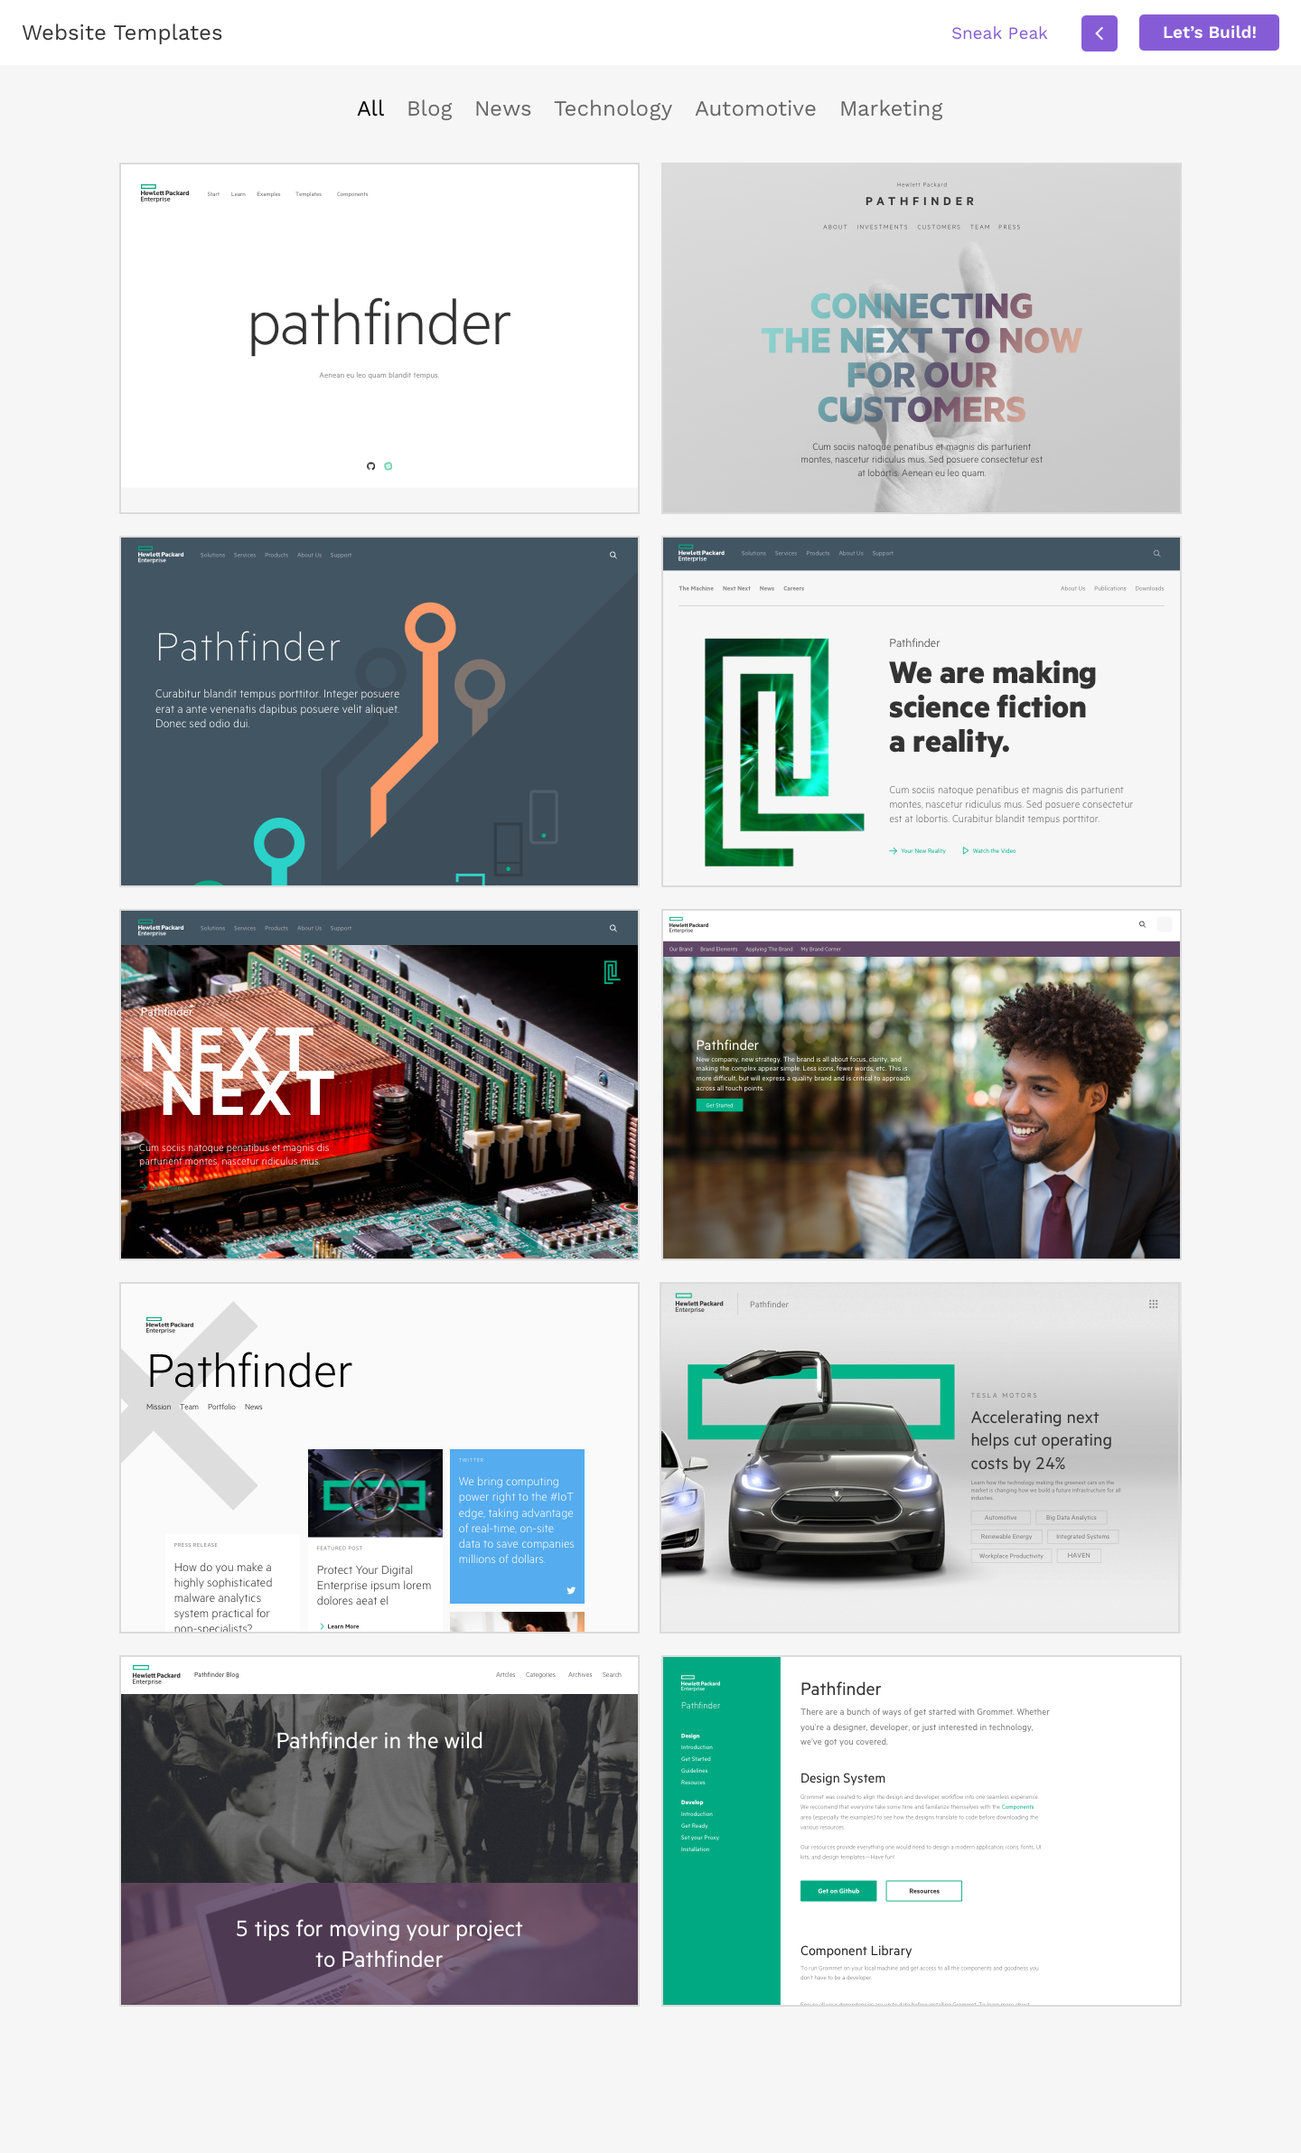
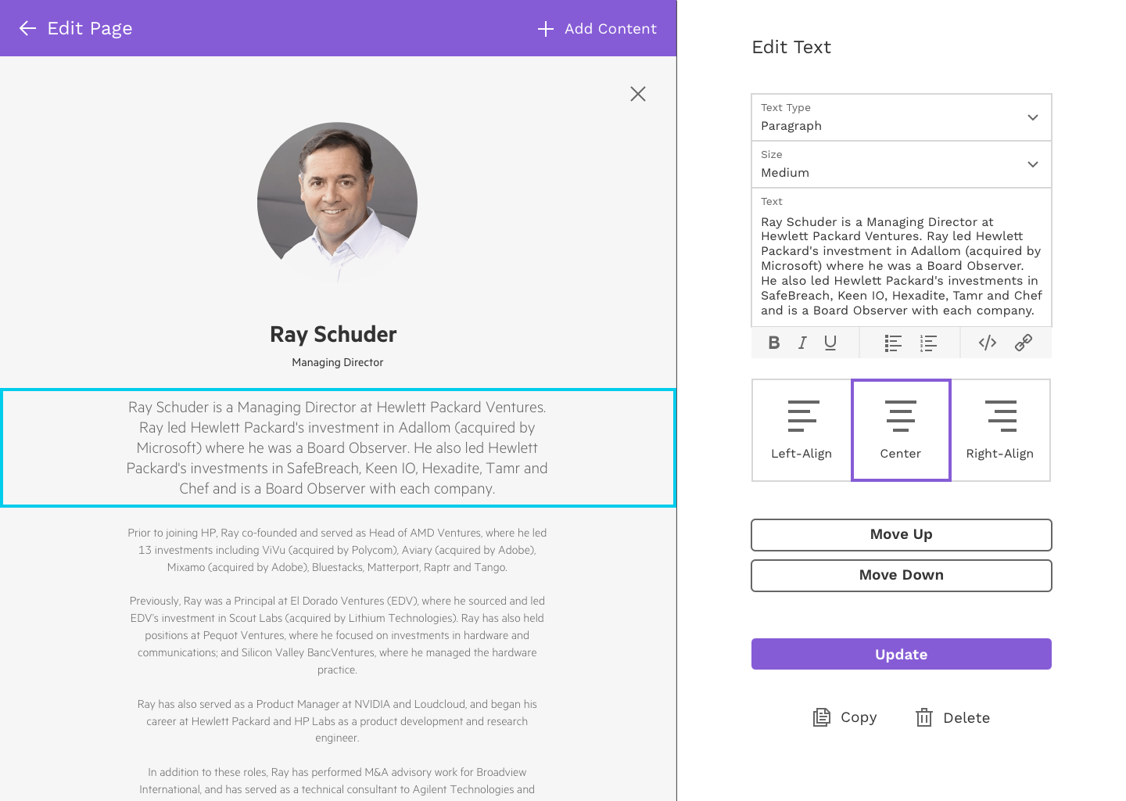
grommet cms

Slide 36
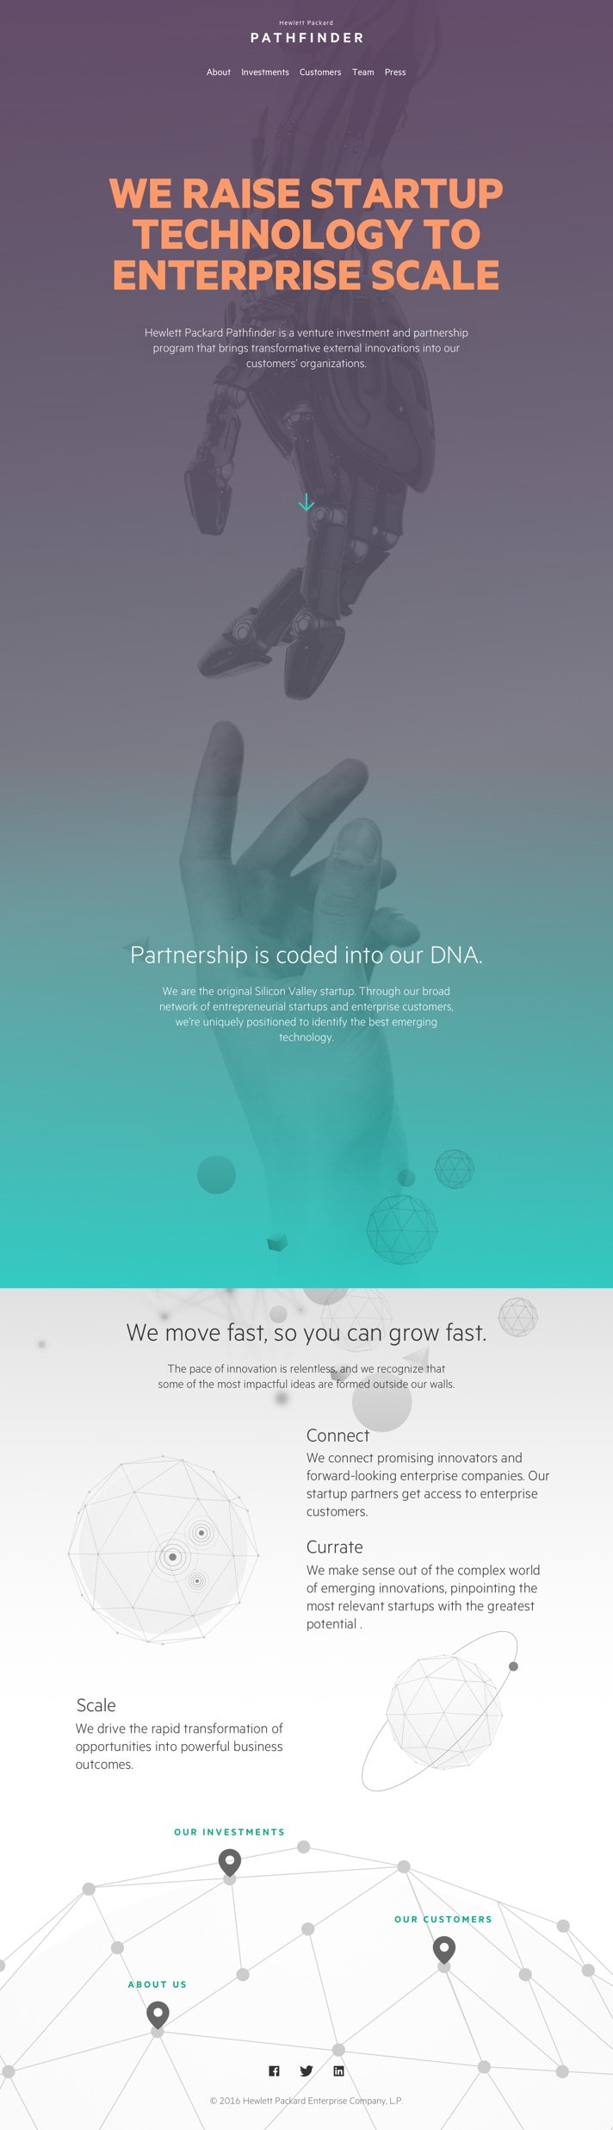
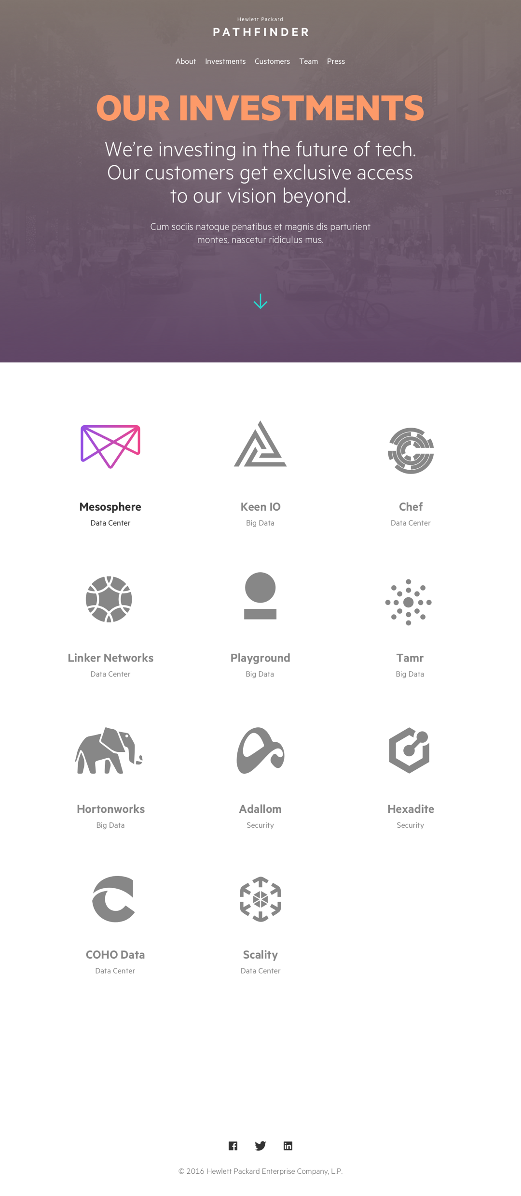
grommet hewlett packard pathfinder www.hewlettpackardpathfinder.com

Slide 37
grommet HPE hyper converged operating environment

Slide 38
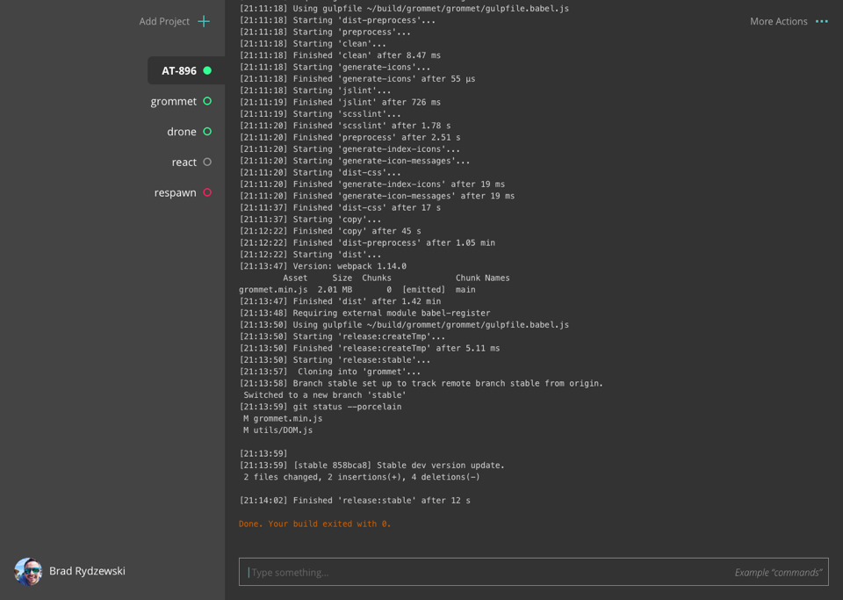
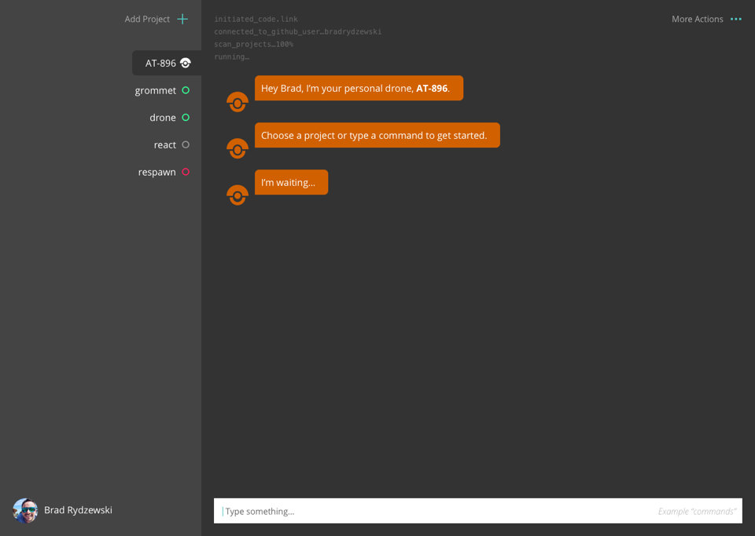
grommet drone

Slide 39
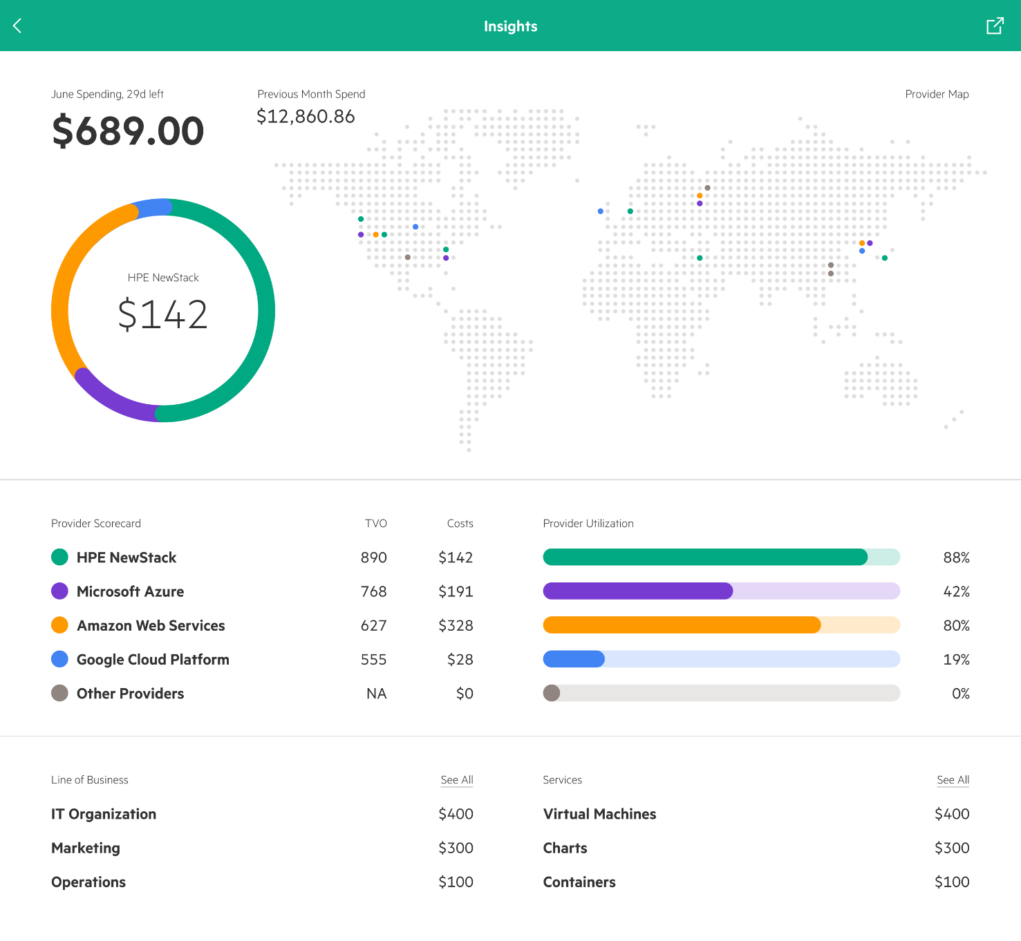
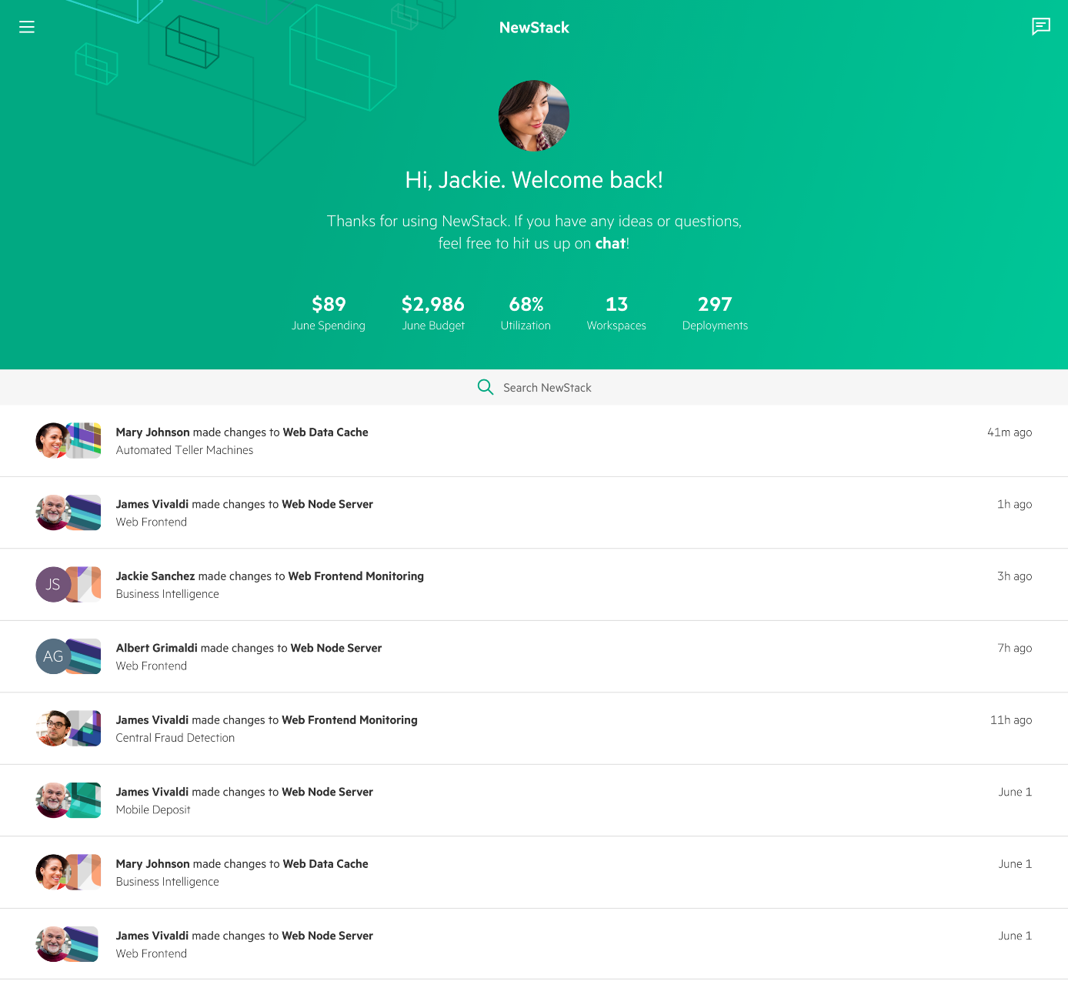
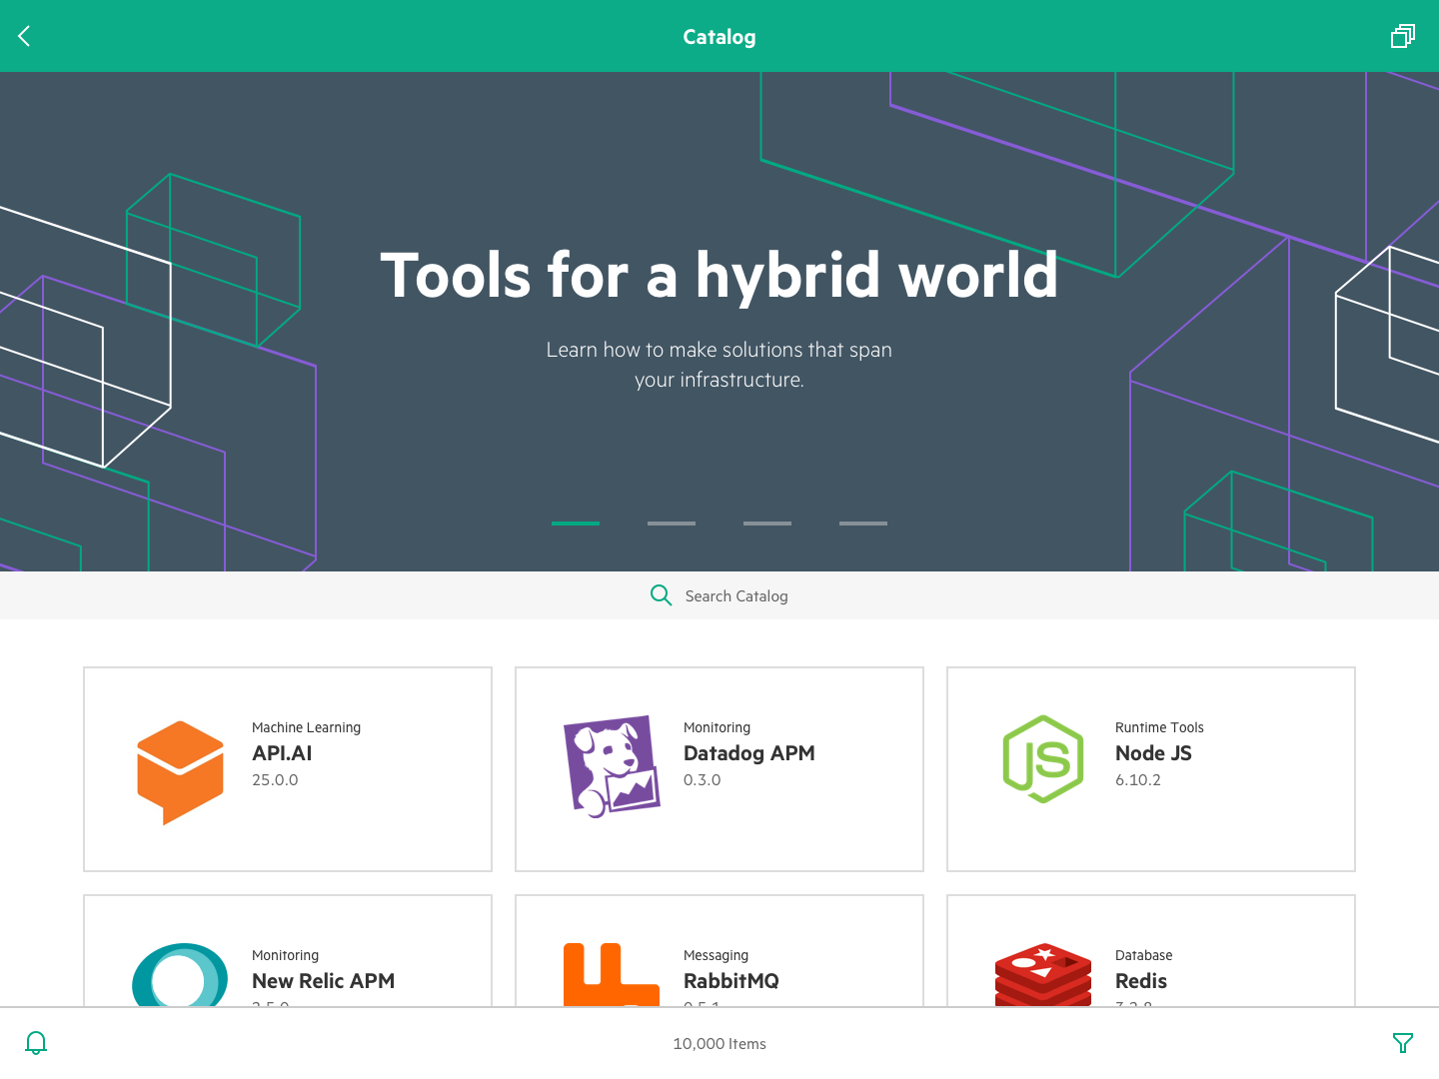
grommet HPE NewStack

Slide 40


grommet recognition
2016 Tech Innovator Award
HPE HC380
2016 Magic Quadrant Leader
Integrated Systems
2016 Tech Innovator Finalist
HPE OneView 3

Slide 41

Adaptation is the name of the game. Technology changes quick but the core values don’t.
Easy-to-use and useful hasn’t changed over the years.

Slide 42
Thank you
www.grommet.io

